Slide 1


Part I
Presentation by: Quincy Jacobs
Notes:
Part I will contain explanations for Examples 1 and 2 in the git repository.
https://github.com/QuincyJacobs/WebGLTutorial

Slide 2
The Tools
Getting all the tools necessary to get started with WebGL is surprisingly easy.
Check your browser’s compatibility: webglreport.com
2. Open your favorite text editor or IDE for JavaScript.
Now you’re good to go.
Notes:
You could download gl-matrix-min.js for easier calculations: glmatrix.net
I will not use it yet.

Slide 3
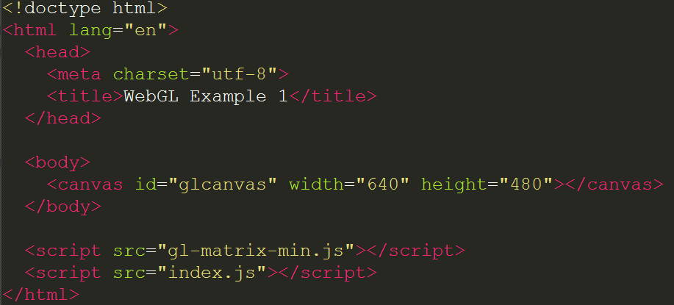
The HTML
Our actual WebGL code goes into index.js
Notes:
All we really need are the scripts and the canvas.

Slide 4
The CSS
Notes:
CSS is not necessary to make beautiful shapes when using WebGL with html5 canvas.

Slide 5
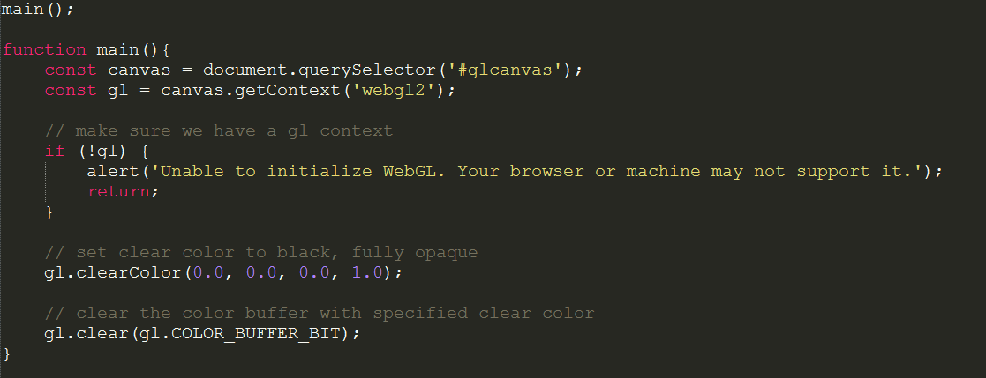
The First Step
Drawing a black background using WebGL
Notes:
The very first step is traditional javascript, we look for our canvas so we can draw to it later.
Next we want the WebGL context so we can start using the built-in WebGL functionality in your browser.
I also added a step that alerts when a WebGL context has not been found, but this is optional.
Next we set a clearColor. WebGL will cideally clear the screen every frame. With the last 2 instructions we specify what this color will be, and then actually make WebGL clear the screen.
Note the clearing of the screen is done only once, we have no interaction or updates at all. We will be talking about a drawing loop in a later slide.

Slide 6
The First Step
You can download/clone the code from my Github:
https://github.com/QuincyJacobs/WebGLTutorial

Slide 7
Graphics pipeline
= Adjustable steps (Shaders)
= Automatic steps
Vertex Shader
Shape Assembly
Geometry Shader
Rasterization
Fragment Shader
Tests and Blending

Slide 8
Steps for drawing a triangle
We will need all of the following WebGL objects to draw a triangle:
Vertex array buffer
Element array buffer
Vertex shader
Fragment shader
Shader program

Slide 9
Steps for drawing a triangle
These necessary elements are created and used in the following steps:
Array Buffer Objects
Shaders and Shader Program
Linking Buffers and Shaders
Drawing

Slide 10
Step 1: Array Buffer Objects

Slide 11
Array Buffer Objects
A Vertex Buffer contains information about each vertice, which shaders will use for calculations and translations.
Our vertex buffer will only contain 3d positions for each vertice:
Vertice 1
Vertice 2
Vertice 3
VERTEX BUFFER
Position x
Position y
Position z
Position x
Position y
Position z
Position x
Position y
Position z
…
Notes:
We will start with our vertex buffer. First we need to understand what a vertex buffer is, so we can fill it with usable data. A Vertex Buffer contains information about each vertice which shaders will use for calculations and translations. (more on shaders later)

Slide 12
Array Buffer Objects
How does WebGL interpret the view?
Y: 1
X: -1
X: 1
Y: -1
Notes:
To find out what kind of positions we put into our buffer, we first need to find out how WebGL sees the view, and how our input data will translate to that.

Slide 13
Array Buffer Objects
What will our triangle look like?
Y: 1
X: -1
X: 1
Y: -1
Notes:
We first need to visualize what we wish to accomplish.

Slide 14
Array Buffer Objects
What data do we need?
Y: 1
X: 0.0
Y: 0.5
Z: 0.0
X: -1
X: 1
X: -0.5
Y: -0.5
Z: 0.0
X: 0.5
Y: -0.5
Z: 0.0
Y: -1
Notes:
Now we decide our type and ascertain the points we need as vertices. The usual type for positions are floats, so we will use floats as well

Slide 15
Array Buffer Objects
The result:
Let’s format this mess…

Slide 16
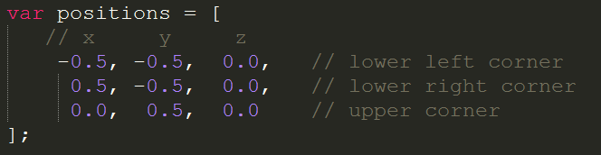
Array Buffer Objects
The result:
Better!

Slide 17
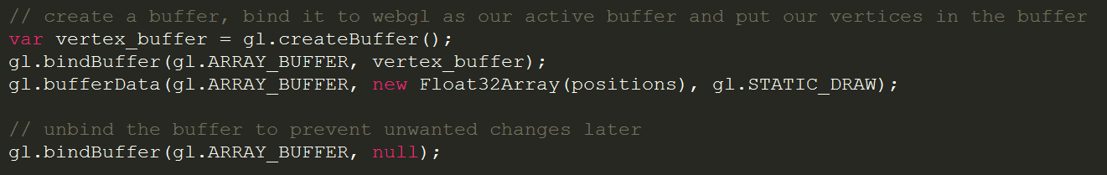
Array Buffer Objects
Now let’s prepare our buffer so WebGL can eventually send it to the shaders.
Notes:
bufferData arguments:
Type of buffer
Bufferdata (32 bit float array of positions in our case)
Type of drawing (STATIC_DRAW indicates to WebGL that the vertex data will not move at all, so WebGL can optimize. There are more options, but for frequently changing parts use gl.DYNAMIC_DRAW

Slide 18
Array Buffer Objects
Next we will need a buffer that holds the indices that form a triangle.
Y: 1
2
0 ->
1 ->
2 ->
X: -1
X: 1
0
1
Y: -1
Notes:
The indices seem like double work right now, but will come in handy when defining more triangles in the same vertex buffer. It eliminates the need for a lot of positions that would otherwise be defined twice.

Slide 19
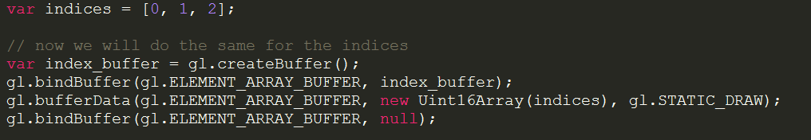
Array Buffer Objects
The Indices will be saved as an Element Array Buffer. The way to do this is similar to the (Vertex) Array Buffer

Slide 20
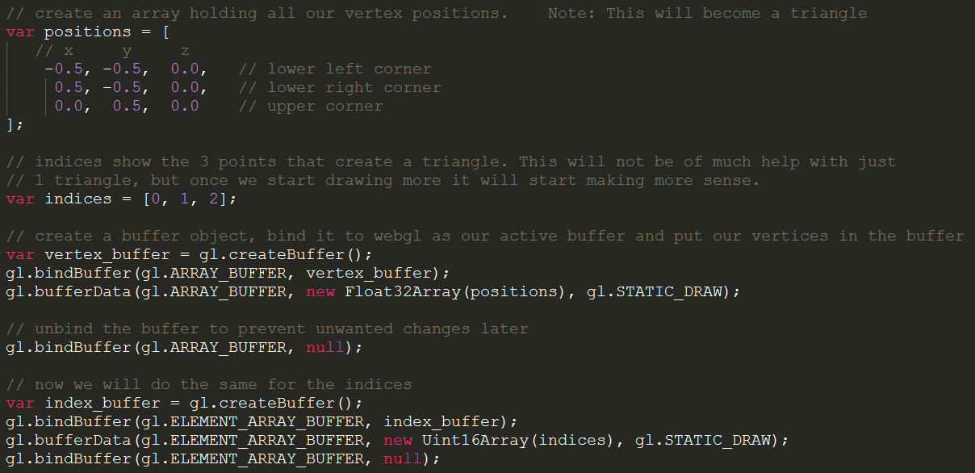
Array Buffer Objects Results
Notes:
This is the resulting code.

Slide 21
Step 2: Shaders and Shader Program

Slide 22
Shaders and Shader Program
As we recall from the graphics pipeline slide, we can supply code for 3 Shaders:
Vertex Shader
Geometry Shader
Fragment Shader
We will only create a Vertex Shader and a Fragment Shader. The Geometry Shader is not necessary.

Slide 23
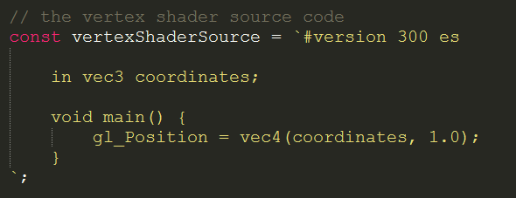
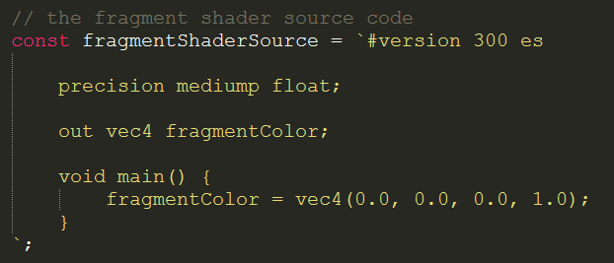
Shaders and Shader Program
Shaders are written in their own language called GLSL (OpenGL Shader Language)
Our Shader code will be defined as a constant string.
Vertex Shader
Fragment Shader
Notes:
The attribute in the Vertex Shader will be the point where we inject our own (vertex) position buffer. From there on WebGL will handle the rest of the pipeline, so the output of the Vertex Shader will be the input of the next step in the Pipeline and so on.
gl_position and gl_fragcolor are standard keywords in GLSL where the Shader will expect a value to supply to the next step in the graphics pipeline.

Slide 24
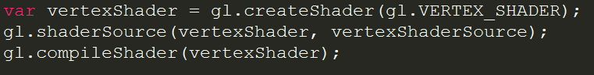
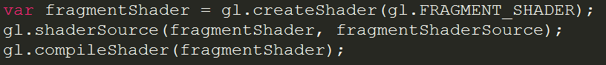
Shaders and Shader Program
In the next step we create Shader Objects, attach the source code, and compile the source code.
Vertex Shader
Fragment Shader
Notes:
The creation of Shader Objects looks a lot like the creation of Vertex Buffer Objects.
The first call is to register the object and get an ID pointing to the object.
The next call connects the Shader object to the shader source.
The last call compiles the shader source into the object.

Slide 25
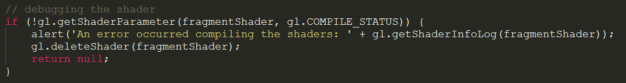
Shaders and Shader Program
These lines will check if the shader compiled and give an error if it was not compiled.

Slide 26
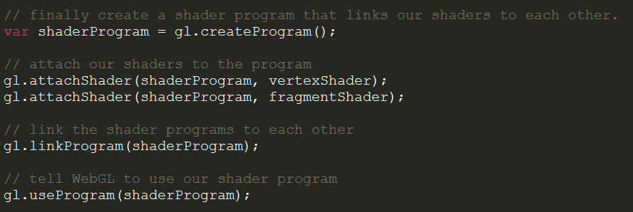
Shaders and Shader Program
Now we connect the shaders in a program and tell WebGL to use the program.
Notes:
First we create a program object (much the same as the Vertex Buffer Object and the Shader Objects)
Then we attach both shaders.
Next we link the shader together into the final program.
Finally we tell WebGL to use our program.

Slide 27
Step 3: Linking Buffers and Shaders

Slide 28
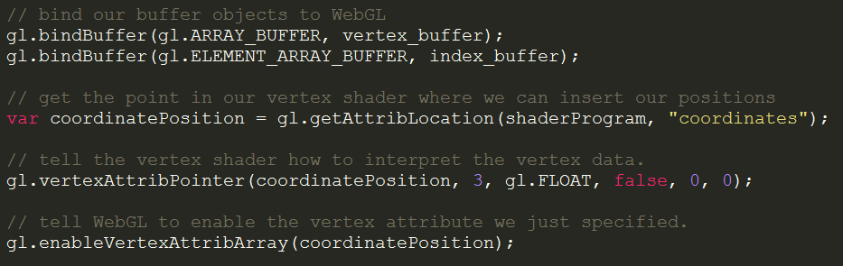
Linking Buffers and Shaders
This is all the code necessary to link the buffers and shaders.
Notes:
The first two lines are lines seen before. We tell WebGL to bind our Vexrtex Buffers again, as we will not modify anything that could change them anymore. The next 2 lines are harder and will be explained in the next slide.
The last line just tells WebGL to enable whatever we told it to interpret and into which object.

Slide 29
Linking Buffers and Shaders
These 2 lines tell WebGL where to insert our Buffers into the shaders and how to interpret the Buffers.
Notes:
The first call makes WebGL look for the “coordinates” variable in the shaderProgram. We defined an input in our vertex shader called coordinates which we will now use to input our shader data.
Next we tell WebGL how to input our Vertex Array into this input per point. This is 3 positions (3d vector), as FLOAT types, with 0 bytes in between those 3 Floats per point, and no additional data to skip in front of the array.

Slide 30
Step 4: Drawing

Slide 31
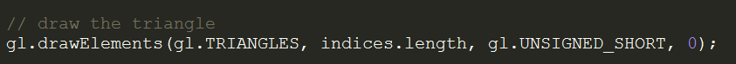
Drawing
This line tells WebGL to start drawing triangles.
Notes:
First we tell WebGL to interpret our positions as triangles.
Then we tell WebGL we have (indices.length) amount of positions to insert.
Next is the Type which our Element Buffer Object contains.
Lastly is the offset. (This is to ignore a certain amount of bytes at the start of the array if we have additional information at the start of the array.)

Slide 32
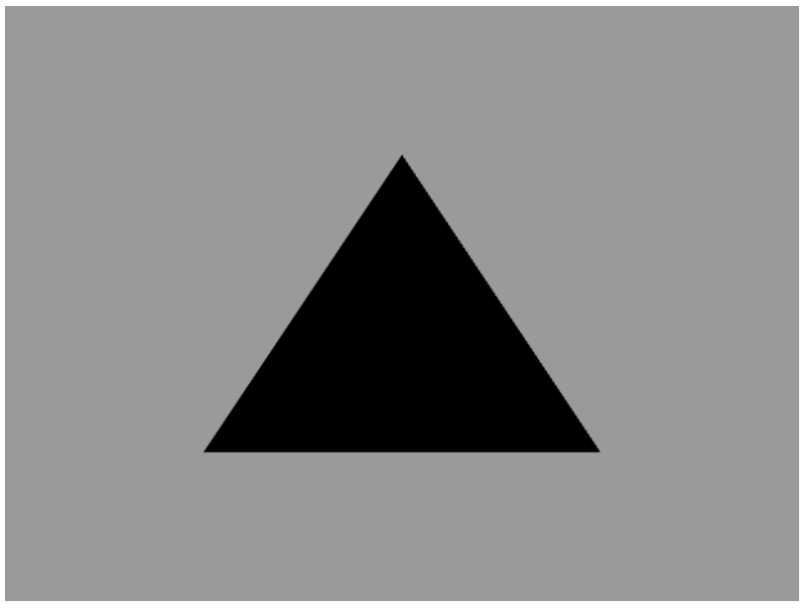
The result

Slide 33
Afsluiting
Thanks for listening.

Slide 35
Part II
Presentation by: Quincy Jacobs
Notes:
Part II will contain explanations for Examples 3 in the git repository and make a start with vector math .
https://github.com/QuincyJacobs/WebGLTutorial

Slide 36
Session preview
This session will focus on these points:
Colors array and (color) Vertex Buffer Object
Combining the Color and Position Vertex Buffers
Transformations and the math behind them
Part 1: 2D vectors

Slide 37
Step 1: Colors array and
(color) Vertex Buffer Object

Slide 38
Colors array and (color) Vertex Buffer Object
Similar to the position vertex array the color vertex array will have 3 elements: r, g, b.
Vertice 1
Vertice 2
Vertice 3
VERTEX BUFFER
R
G
B
R
G
B
R
G
B
…
How does WebGL interpret color data?
Notes:
If you remember the position Vertex Array from the previous presentation, you’re in luck. The color Vertex Array will be almost the same as it also contains 3 objects per vertice. Instead of x, y, z this will become r, g, b. We leave out the alpha channel for simplicities sake.

Slide 39
Colors array and (color) Vertex Buffer Object
WebGL takes in positive floats as RGBA color values between 0 and 1
R
0.0 … 1.0
G
0.0 … 1.0
B
0.0 … 1.0
What will the raw data look like in code?
Notes:
The data will be given as float. It is our choice to hand it as float our a binary value, but for simplicity let’s pick float again. The values offered can only be positive. If any value is given that is not from 0.0 to 1.0, the vertex will be black.

Slide 40
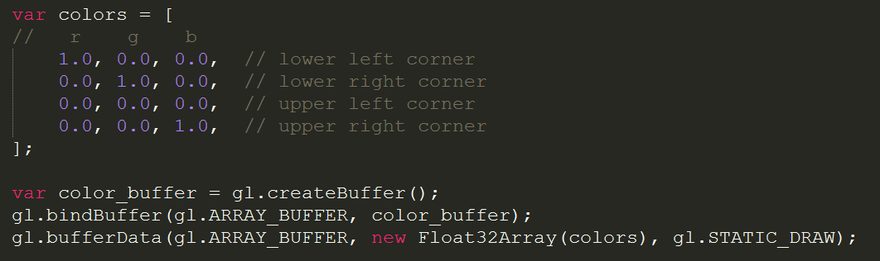
Colors array and (color) Vertex Buffer Object
The array closely resembles the position array, and even the creation of the object is the same.
Where do we insert our colors in the shader?
Notes:
The array is exactly the same as the positions array. The colors have the same amount of vertices (4). The array buffer is also almost the same as the position array buffer.

Slide 41
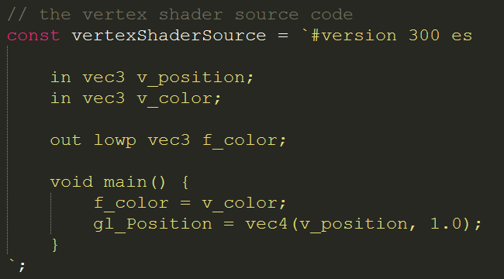
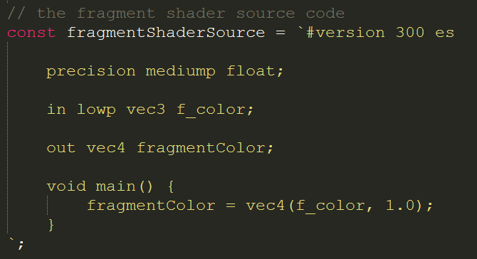
Colors array and (color) Vertex Buffer Object
We have to specify a new input variable in the Vertex Shader, and give it to the Fragment Shader
Next we will tie everything together in the code
Notes:
Compare the shader code to the cade of the previous presentation. You can clearly see a new ‘in’ variable being specified in both, and also the vertex shader has an out f_color. For convenience I have called all vertex shader variables v_name and fragment shader variables f_name.

Slide 42
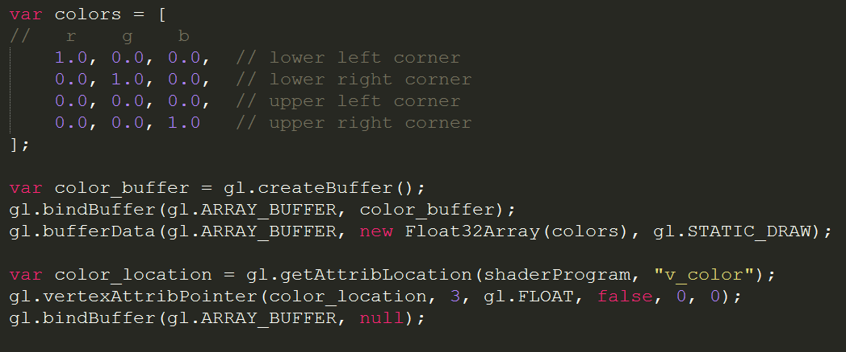
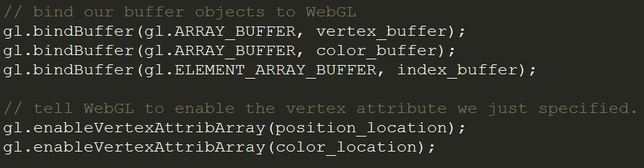
Colors array and (color) Vertex Buffer Object
Next we will tie everything together in the code
Notes:
With these lines we have established a way to get colors onto each vertice. Now let’s improve this so we can fit our colors and positions into a single buffer!

Slide 43
Step 2: Combining the Color and
Position Vertex Buffers

Slide 44
Combining the Color and Position Vertex Buffers
Vertice 1
Vertice 2
Vertice 3
POSITION BUFFER
Position x
Position y
Position z
Position x
Position y
Position z
Position x
Position y
Position z
…
Vertice 1
Vertice 2
Vertice 3
COLOR BUFFER
R
G
B
R
G
B
R
G
B
…
How should we combine these 2 arrays?
Notes:
These are the position and color buffers we created earlier. We have to combine them in some way that would be convenient for WebGL. Luckily WebGL support a certain way to read data from the array in an orderly fashion, but we’ll come to the reading in part later.

Slide 45
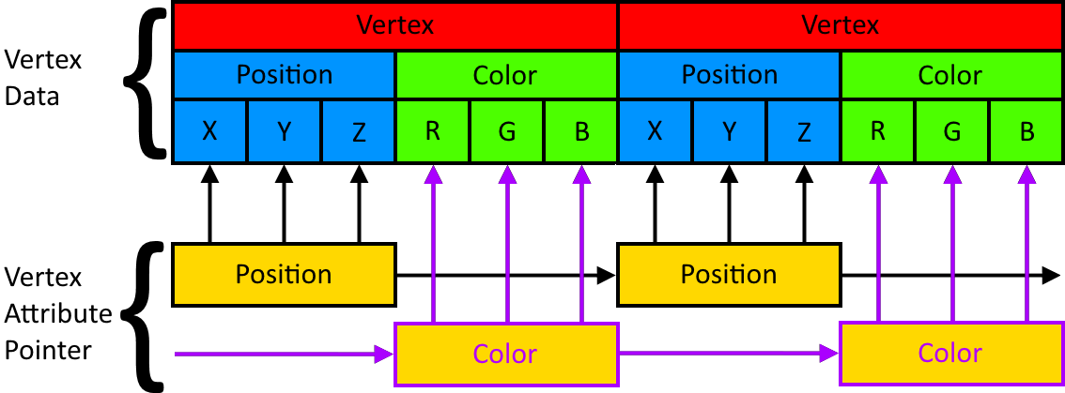
Combining the Color and Position Vertex Buffers
We simply place the position and color of each vertex right behind each other
How would WebGL filter these out and give them to the right in variable in the vertex shader?
Notes:
The answer is to simply declare each vertex after each other. Each vertex has 6 floats now, and the position and color come right behind each other for each vertex.

Slide 46
Combining the Color and Position Vertex Buffers
We use 2 vertex attribute pointers, one for positions and one for colors. Now let’s see the code.
Notes:
The positions and colors vertex attribute pointers cycle in getting 3 floats, then skipping 3. The color vertex attribute skips 3 at first and then gets 3 and so on.

Slide 47
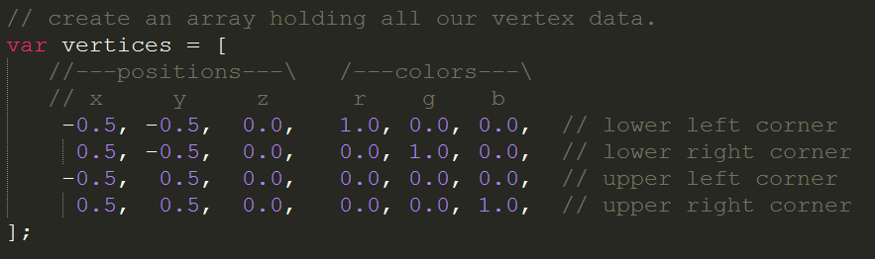
Combining the Color and Position Vertex Buffers
The code simply pastes the rgb values after the xyz values.
How will we feed the Vertex fragment with this data?

Slide 48
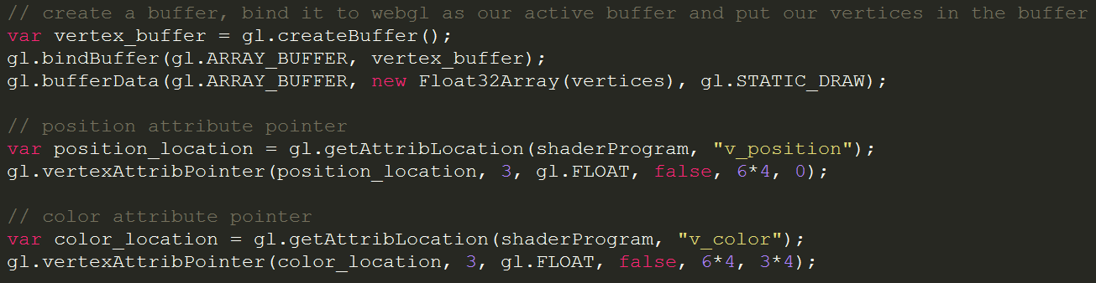
Combining the Color and Position Vertex Buffers
We use 2 pointers as specified in the image before.
There is just one more loose end left.
Notes:
What happens is is not so complex once you know every parameter of vertexAttribPointer.
The 1st parameter is the pointer to the variable in the shader we want to supply data to.
The 2nd parameter specifies how much of an object we want to supply.
The 3rd parameter is the type of object we want to supply.
The 4th parameter is a Boolean indicating if data should be normalized. This only has meaning when you work with binary data, so a false for us.
The 5th parameter specifies the space a single vertex takes in bytes. We have 3 positions and 3 colors so 6 float values. A float in javascript is 32 bits(see Float32Array above) so 4 bytes. This should be 6*8.
The 6th parameter is the offset in bytes at which to start reading data from at the beginning of the array. Colors should skip 3 elements at the start, so 3*4.

Slide 49
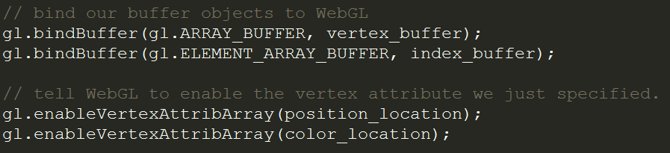
Combining the Color and Position Vertex Buffers
We remove our color buffer and don’t bind it anymore.
The location is still necessary as that is the point in the shader we will feed data to.

Slide 50
Step 3: Transformations and the math
behind them
Part 1: 2D vectors
Disclaimer: I am not a mathematician

Slide 51
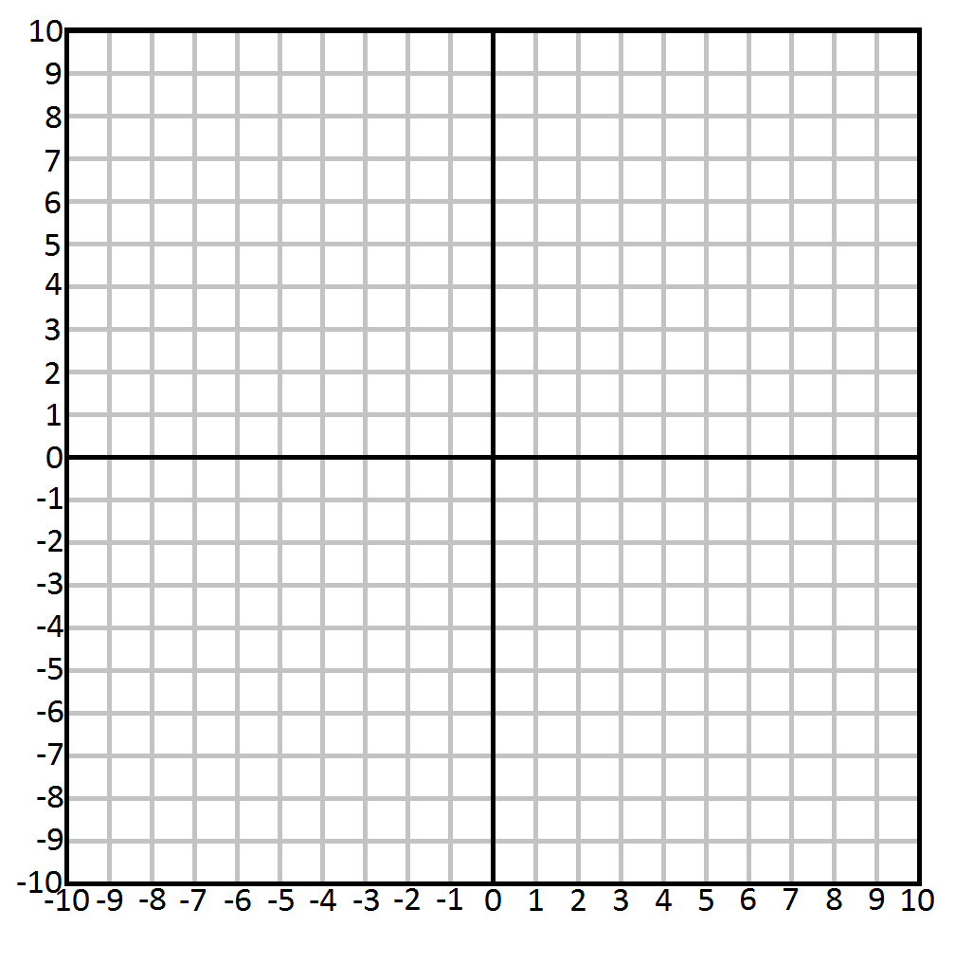
Math part 1: 2D vectors
Let’s start off with 2D examples and slowly work into 3D and transformations.
This is a 2D Cartesian system.
Notes:
The Cartesian space is the space you might remember from drawing graphs in math at school.

Slide 52
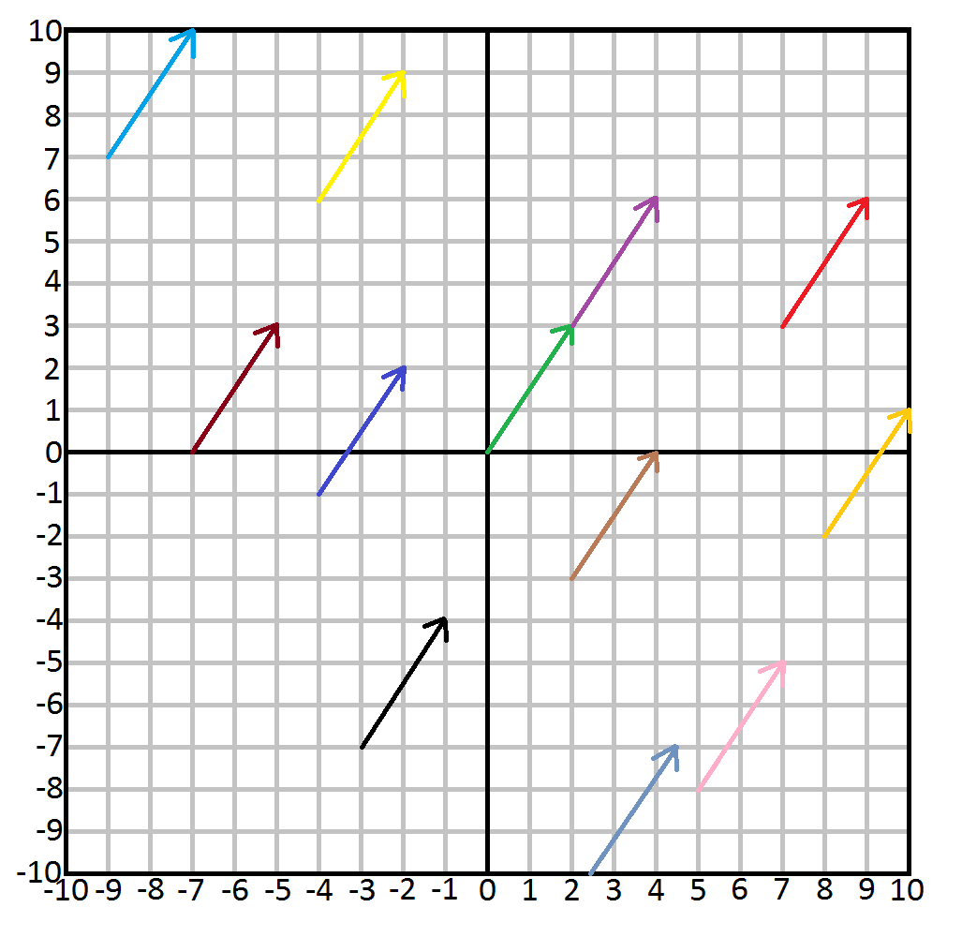
Math part 1: 2D vectors
This is a 2D Cartesian system with vectors.
Which arrow indicates vector (2, 3)?
Notes:
This is pure mathematical, in the actual code we use vectors for many different purposes. Mathematically a vector only indicates direction and magnitude. In this case all the arrows indicate the vector (2, 3) as they all travel 2 positions in the positive x axis, and 3 in the positive y axis. Vector’s are thus not positions, unlike we have been using them so far.

Slide 53
Math part 1: 2D vectors
All of them are the same vector.
A vector in mathematics indicates only 2 things:
Direction
Magnitude
Math part 1: 2D vectors
A vector is usually notated with a bold symbol or a symbol with an arrow on top.
x
y
v = v =
The 2 numbers in a vector are usually displayed on top of each other for convenience
Notes:
As the vector can only indicate Direction and Magnitude, position will mathematically not be indicated with a vector. In programming we do abuse the vector type for this purpose because it fits perfectly.

Slide 54
Math part 1: 2D vectors
Vectors can also be manipulated in many different ways.
Let’s start with scalar operations:
2
5
v * s =
2 * 5
5 * 5
=
10
25
Vector: v = v =
Multiplication:
Scalar: s = 5
v / s =
2 / 5
5 / 5
=
0.4
1
Division:
The scalar will simply be applied to every member of the vector, even with 3D vectors.
Addition and Subtraction with just a scalar are weird:

Slide 55
Math part 1: 2D vectors
Vectors can also be manipulated in many different ways.
Let’s start with scalar operations:
v + s =
2 + 5
5 + 5
=
7
10
Addition:
2
5
v - s =
2 - 5
5 - 5
=
-3
0
Vector: v = v =
Subtraction:
Scalar: s = 5
v * s =
2 * 5
5 * 5
=
10
25
Multiplication:
v / s =
2 / 5
5 / 5
=
0.4
1
Division:
The scalar will simply be applied to every member of the vector, even with 3D vectors.
Why are adding and subtracting scalars a weird thing to do to vectors?

Slide 56
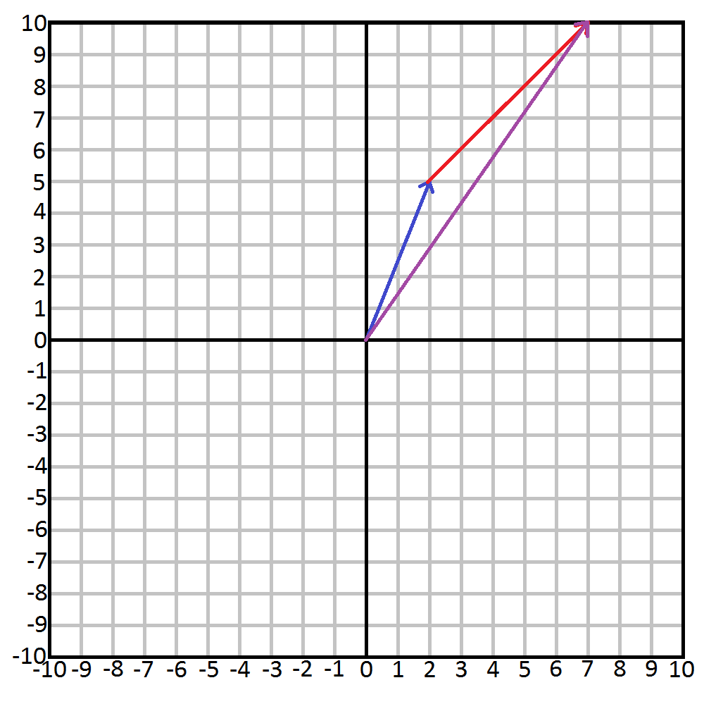
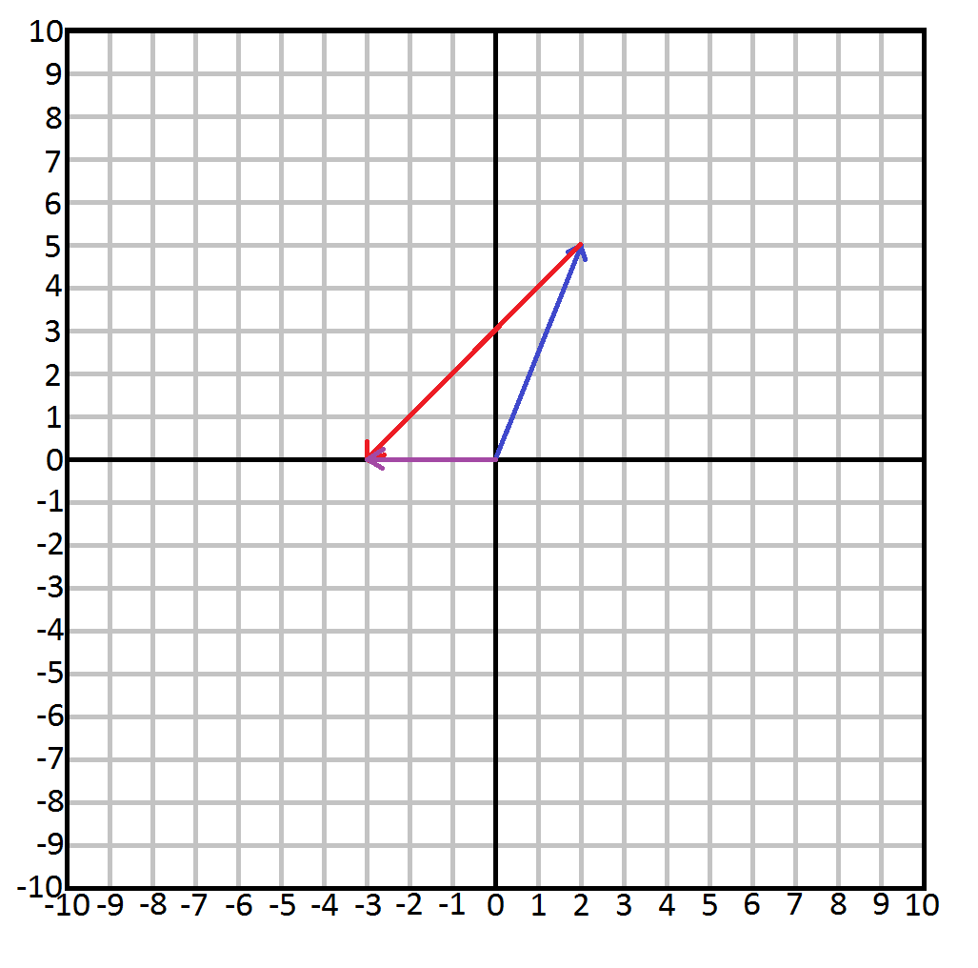
Math part 1: 2D vectors
Addition and subtraction can only move a vector like a bishop in chess.
There is no correlation because both direction and magnitude change in weird ways.
2
5
Vector: v = v =
Scalar: s = 5
v + s =
2 + 5
5 + 5
=
7
10
v - s =
2 - 5
5 - 5
=
-3
0
Addition:
Subtraction:
Multiplying and Dividing by a scalar is much more useful.
Notes:
Adding and subtracting a scalar from a vector is weird because moving like a bishop says nothing about a vector, as vectors do not have positions. The direction and magnitude will change without any correlation to the original vector.

Slide 57
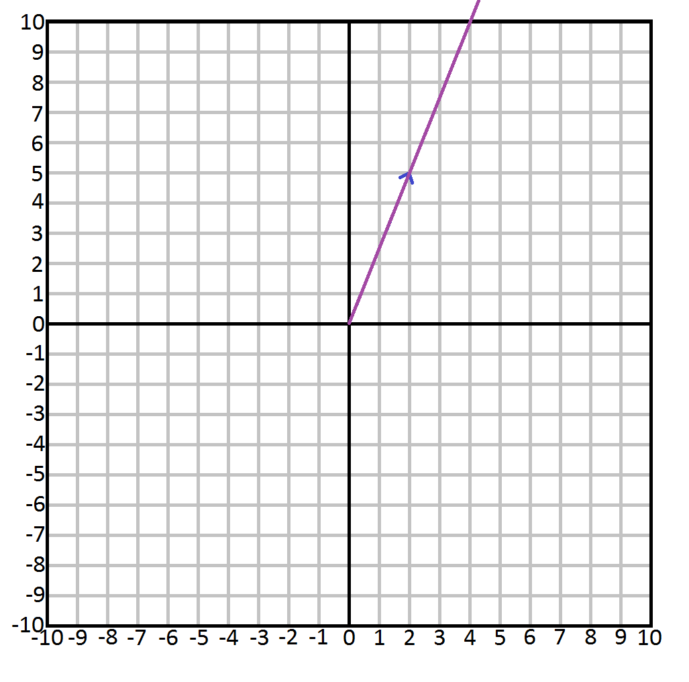
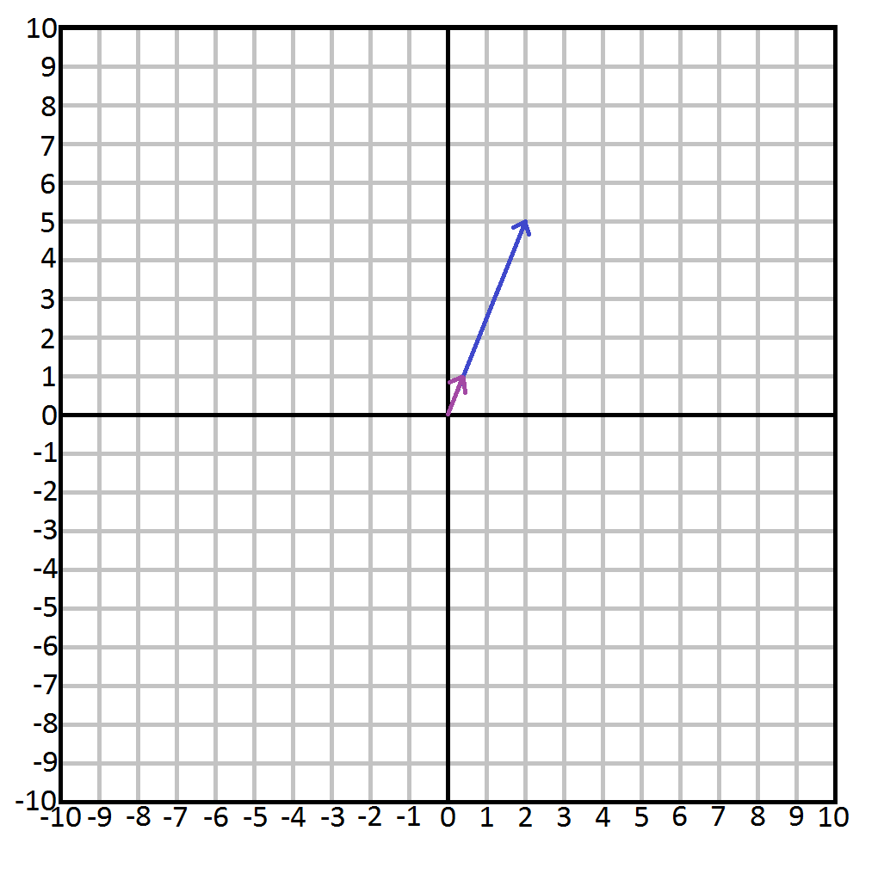
Math part 1: 2D vectors
Multiplication and Division lengthen or shorten the distance of the vector.
The direction will remain, making them very useful.
2
5
Vector: v = v =
Scalar: s = 5
v * s =
2 * 5
5 * 5
=
10
25
v / s =
2 / 5
5 / 5
=
0.4
1
Multiplication:
Division:
Another useful operation is flipping the vector. Any idea how you can do this?

Slide 58
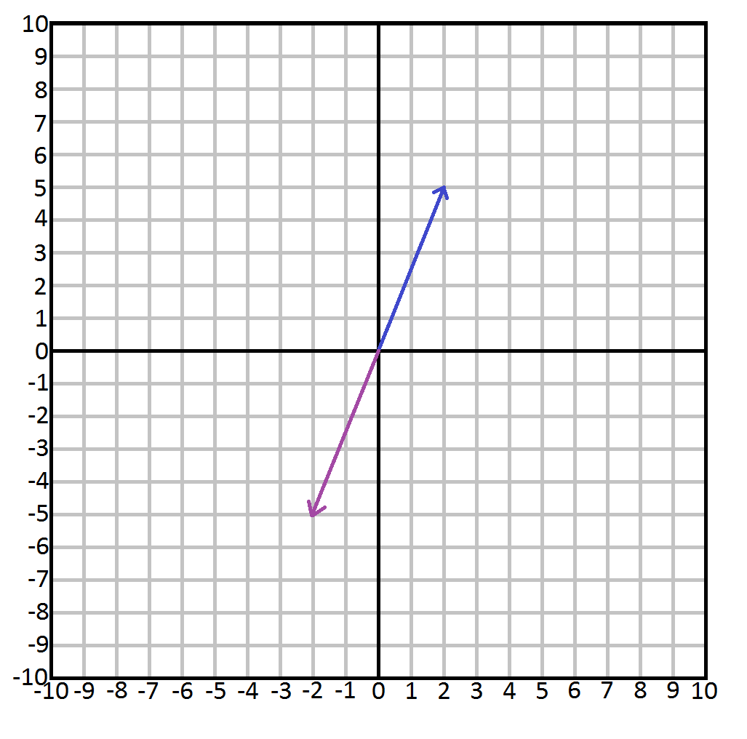
Math part 1: 2D vectors
Flipping a vector is done by simple multiplying the vector with the scalar -1.
2
5
Vector: v = v =
Scalar: s = -1
v * s =
2 * -1
5 * -1
=
-2
-5
Multiplication:
Let’s continue to vector on vector operations.

Slide 59
Math part 1: 2D vectors
Take these 2 vectors:
2
5
3
1
v = v =
w = w =
v + w =
2 + 3
5 + 1
=
5
6
v - w =
2 - 3
5 - 1
=
-1
4
Addition:
Subtraction:
Seeing this visually will make it much clearer.
Notes:
This example shows why it is easier to write the numbers on top of each other. There are many other ways to manipulate vectors, like using a scalar to add/subtract etc, the dot product, the cross product, and many more. See http://higherorderfun.com/blog/2012/06/03/math-for-game-programmers-05-vector-cheat-sheet/ for more information

Slide 60
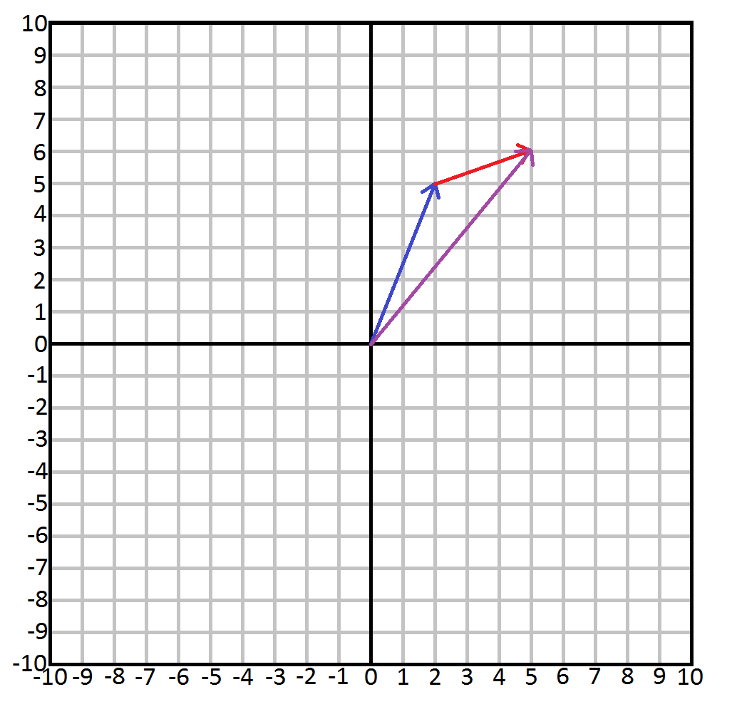
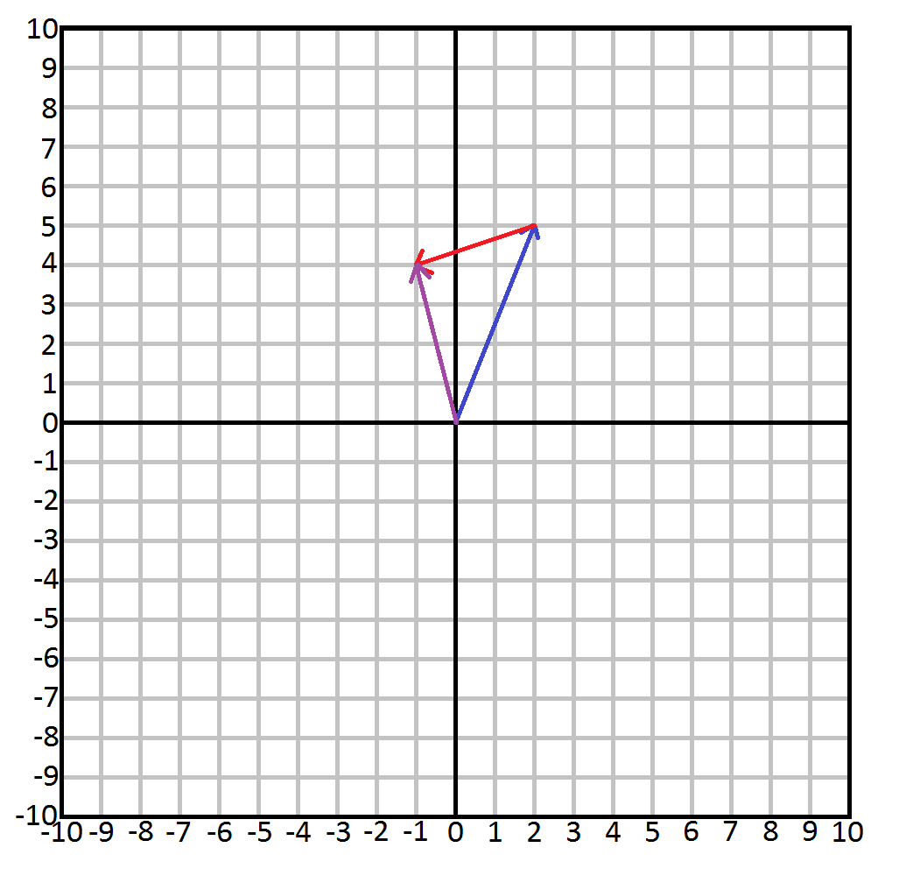
Math part 1: 2D vectors
This is the visual representation of the Addition and Subtraction of our v and w vectors
Addition
Subtraction
Will these vectors have the same outcome regardless of order?
Notes:
Just placing the vectors head to tails will give us the answer for addition and subtraction.

Slide 61
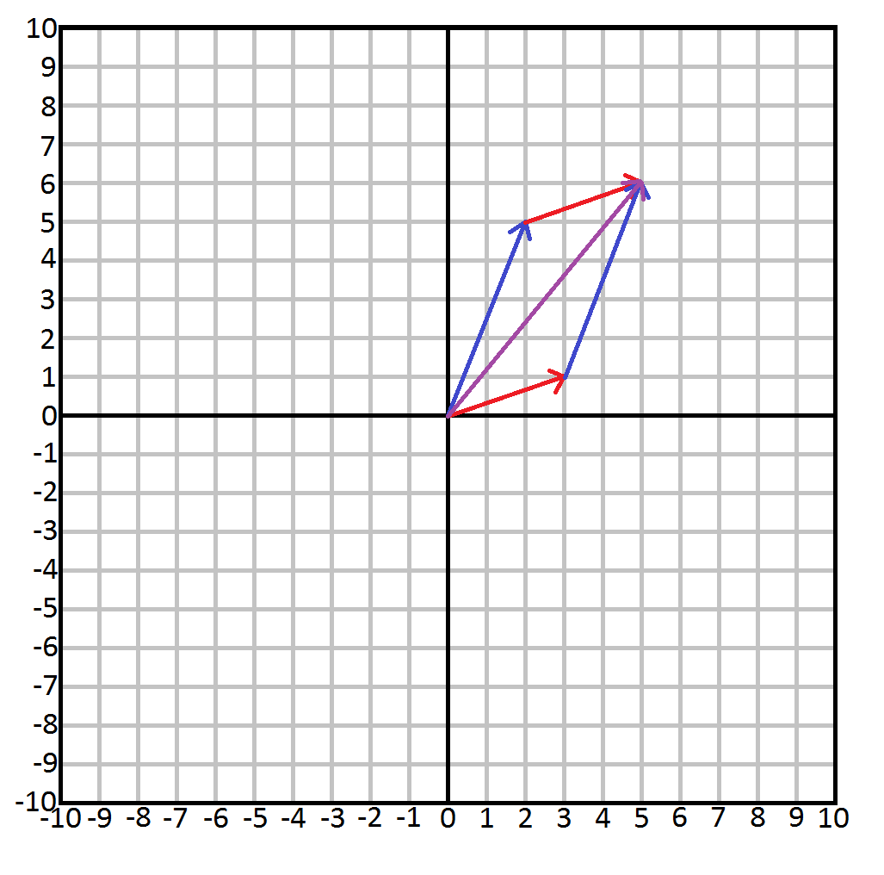
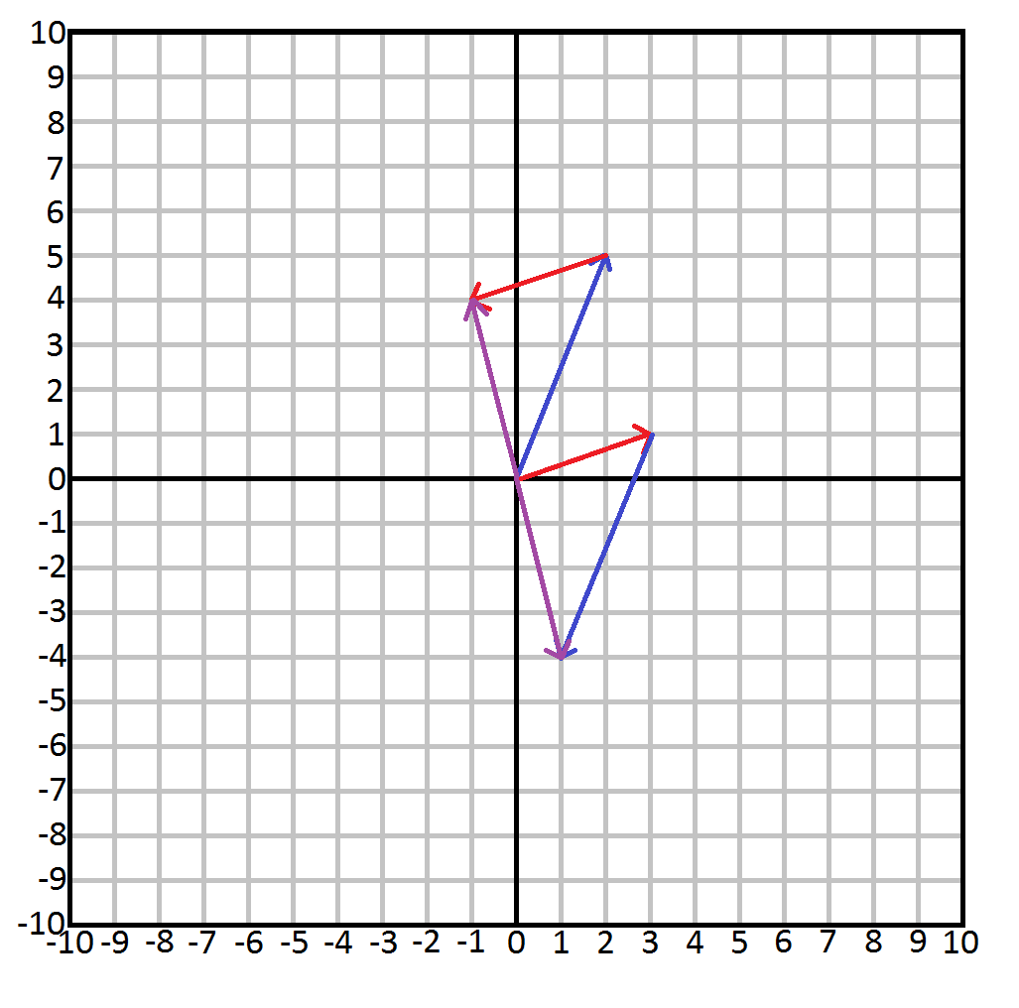
Math part 1: 2D vectors
Addition does, subtraction does not.
Addition
Subtraction
The math will continue at the end of part III

Slide 62
To be continued next time…
Notes:
The same applies for Multiplication and Division, multiplication will always produce the same result while division will not.

Slide 63
Thanks for listening.

Slide 65
Part III
Textures, Vectors, and 4 matrices to move your triangles.
Presentation by: Quincy Jacobs
Notes:
Part III will continue math explanations to get to the result in Example 4 and Example 5.
https://github.com/QuincyJacobs/WebGLTutorial

Slide 66
Session preview
This session will focus on these points:
Adding a texture
Math
2D/3D vectors
Matrices
Applying math in WebGL

Slide 67
Step 1: Adding a texture
Step 2: Math
Step 3: Applying math in WebGL

Slide 68
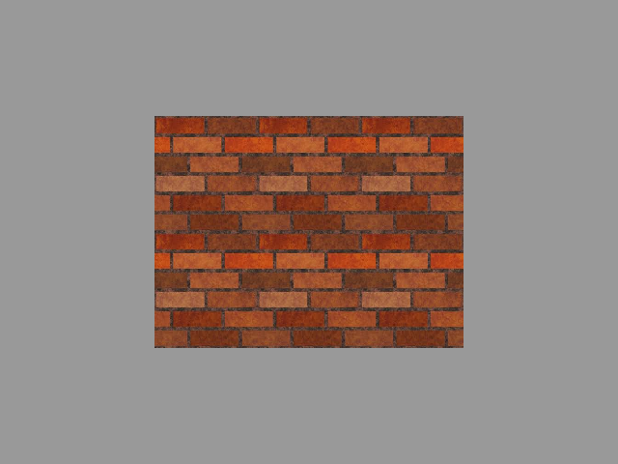
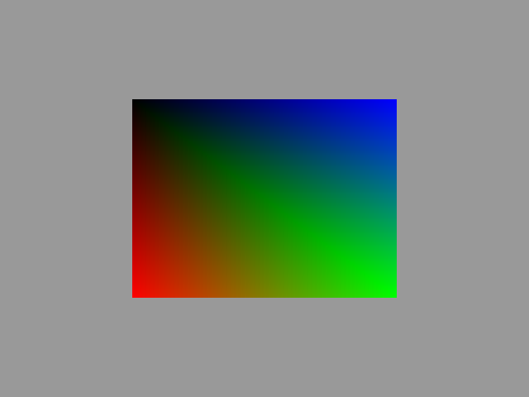

Adding a texture
What we have
What we will get
What we want

Slide 69
Adding a texture
To-do list
Texture object
Loading image
Texture parameters
Texture in shader
Texture “vertices”
Texture attribute pointer

Slide 70
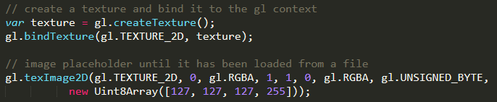
Adding a texture
Creating a texture object.
Let WebGL create the object
Bind the object to WebGL
Create a placeholder image
Notes:
Here we ask WebGL to create a texture object for us in memory, and give us a pointer to it. We save this pointer as the texture variable.
Next we bind the texture to the WebGL context so we can make changes to it. By supplying the TEXTURE_2D type, WebGL knows what calls to expect and how to handle them.
The last line of code sets the image into the texture object. In this case we load in an array pixels in RGBA format. As this isn’t the real image but a placeholder, we load in an array with 1 item holding the RGBA value of a grey color. Later we will overwrite this when the image is correctly loaded.
For the full parameter list on texImage2D look at the following source: https://developer.mozilla.org/en-US/docs/Web/API/WebGLRenderingContext/texImage2D

Slide 71
Adding a texture
To-do list
Texture object
Loading image
Texture parameters
Texture in shader
Texture “vertices”
Texture attribute pointer

Slide 72
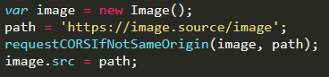
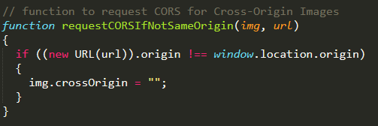
Adding a texture
Loading an image.
Cross-Origin Resource Sharing (CORS)
Notes:
Further reading in CORS: https://developer.mozilla.org/en-US/docs/Web/HTTP/CORS

Slide 73
Adding a texture
To-do list
Texture object
Loading image
Texture parameters
Texture in shader
Texture “vertices”
Texture attribute pointer

Slide 74
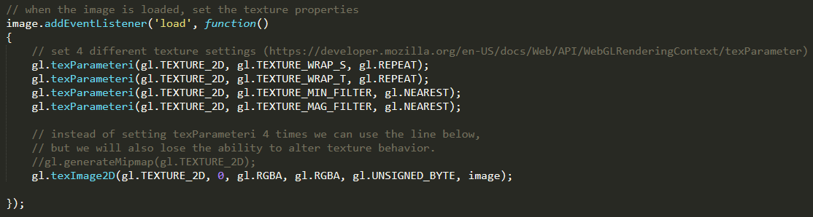
Adding a texture
Set texture parameters after image load
Notes:
Texture settings documentation: https://developer.mozilla.org/en-US/docs/Web/API/WebGLRenderingContext/texParameter
texImage2D parameters:
gl.texImage2D(target, level, internalformat, width, height, border, format, type, ImageData source);
or
gl.texImage2D(target, level, internalformat, format, type, ImageData? pixels);

Slide 75
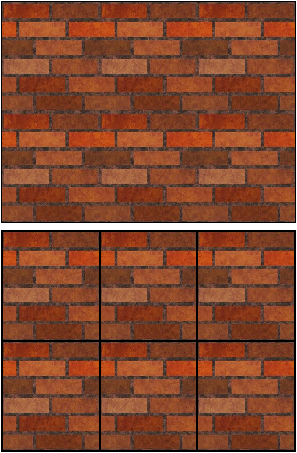
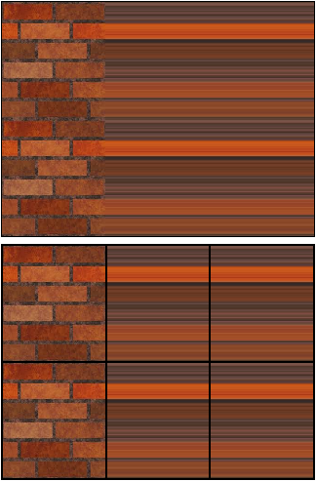
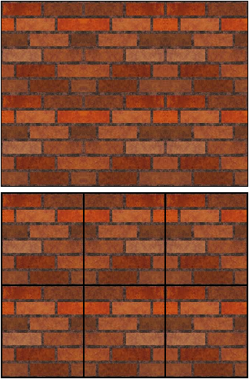
Adding a texture
TEXTURE_WRAP_S
3 options for TEXTURE_WRAP_S:
gl.REPEAT
gl.CLAMP_TO_EDGE
gl.MIRRORED_REPEAT
Notes:
S and T denote the coordinate system for Texture mapping. Theses coordinates are used for cubic mapping. For projecting 2D images on 3D models we use something called UV mapping.
These coordinate notations (ST) and (UV) are chosen because the standard 3D coordinate system already use wxyz.
More information found here: https://stackoverflow.com/questions/10568390/difference-between-u-v-and-s-t-texture-coordinates
“Texture mapping can be accomplished in two steps. A simple approach starts by mapping the four corners of the pixel onto the surface. For a bicubic patch this mapping naturally defines a set of points in the surface's (s,t) coordinate space. Next, the pixel's corner points in the surface's (s,t) coordinate space are mapped into the texture's (u,v) coordinate space The four (u,v) points in the texture map define a quadrilateral that approximates the more complex shape into which the pixel may actually map due to surface curvature. We compute a value for the pixel by summing all texels that lie within the quadrilateral, weighting each by the fraction of the texel that lies within the quadrilateral. If a transformed point in (u,v) space falls outside of the texture map, the texture map may e though of as replicated, like the patterns of Section 2.1.3 Rather than always use the identity mapping between (s,t) and (u,v), we can define a correspondence between the four corners of the 0-to-1 (s,t) rectangle and a quadrilateral in (u,v). When the surface is a polygon, it is common to assign texture map coordinates directly to its vertices.”

Slide 76
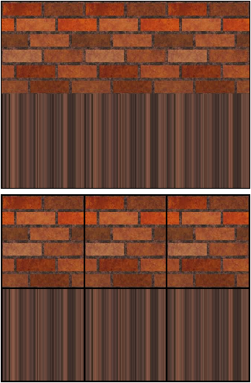
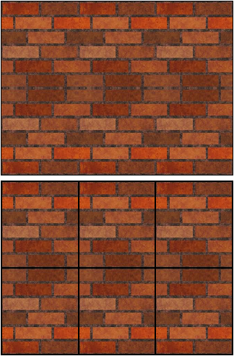
Adding a texture
TEXTURE_WRAP_T
Same as TEXTURE_WRAP_S, but on the y-axis:
gl.REPEAT
gl.CLAMP_TO_EDGE
gl.MIRRORED_REPEAT
Notes:
S and T denote the coordinate system for Texture mapping. Theses coordinates are used for cubic mapping. For projecting 2D images on 3D models we use something called UV mapping.
These coordinate notations (ST) and (UV) are chosen because the standard 3D coordinate system already use wxyz.
More information found here: https://stackoverflow.com/questions/10568390/difference-between-u-v-and-s-t-texture-coordinates
“Texture mapping can be accomplished in two steps. A simple approach starts by mapping the four corners of the pixel onto the surface. For a bicubic patch this mapping naturally defines a set of points in the surface's (s,t) coordinate space. Next, the pixel's corner points in the surface's (s,t) coordinate space are mapped into the texture's (u,v) coordinate space The four (u,v) points in the texture map define a quadrilateral that approximates the more complex shape into which the pixel may actually map due to surface curvature. We compute a value for the pixel by summing all texels that lie within the quadrilateral, weighting each by the fraction of the texel that lies within the quadrilateral. If a transformed point in (u,v) space falls outside of the texture map, the texture map may e though of as replicated, like the patterns of Section 2.1.3 Rather than always use the identity mapping between (s,t) and (u,v), we can define a correspondence between the four corners of the 0-to-1 (s,t) rectangle and a quadrilateral in (u,v). When the surface is a polygon, it is common to assign texture map coordinates directly to its vertices.”

Slide 77
Adding a texture
TEXTURE_MIN_FILTER and TEXTURE_MAG_FILTER
Control the stretching of the image with 6 options:
GL_NEAREST - (no filtering, no mipmaps)
GL_LINEAR - (filtering, no mipmaps)
GL_NEAREST_MIPMAP_NEAREST - (no filtering, sharp switching between mipmaps)
GL_NEAREST_MIPMAP_LINEAR - (no filtering, smooth transition between mipmaps)
GL_LINEAR_MIPMAP_NEAREST - (filtering, sharp switching between mipmaps)
GL_LINEAR_MIPMAP_LINEAR - (filtering, smooth transition between mipmaps)
Notes:
Min = Minification
Mag = Magnification
Nearest is the default option.
For more info on this parameter, see the OpenGL Programming Guide: http://www.glprogramming.com/red/chapter09.html#name3

Slide 78
Adding a texture
To-do list
Texture object
Loading image
Texture parameters
Texture in shader
Texture “vertices”
Texture attribute pointer

Slide 79
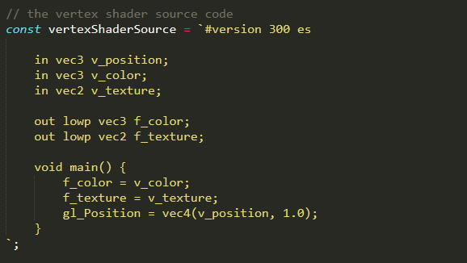
Adding a texture
Vertex shader
Abuse the vertex shader as a conduit
Notes:
Unlike color and position, the texture is a Vec2. This is because it only has 2 dimensions: S and T.

Slide 80
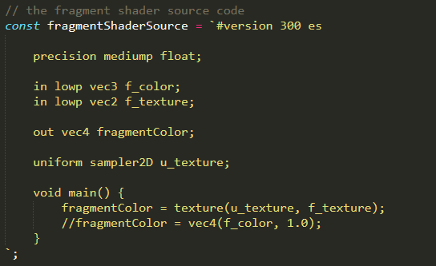
Adding a texture
Fragment shader
Notes:
Set precision
precision mediump float;
Receive variables from the vertex shader
in lowp vec3 f_color;
in lowp vec2 f_texture;
Define the output variable
out vec4 fragmentColor;
Get the input image through the Sampler2D
uniform sampler2D u_texture;
Put WebGL to work with the texture image and coordinates
fragmentColor = texture(u_texture, f_texture);
lowp = low precision
mediump = medium precision

Slide 81
Adding a texture
To-do list
Texture object
Loading image
Texture parameters
Texture in shader
Texture “vertices”
Texture attribute pointer

Slide 82

Adding a texture
Inputting texture coordinates
The actual texture
Desired result

Slide 83
Adding a texture
The coordinates for the image itself
0.0 : 0.0
1.0 : 0.0
0.0 : 1.0
1.0 : 1.0
Notes:
The coordinates shown are the S and T coordinates (which is just a pseudonym for X and Y as discussed earlier)

Slide 84
Adding a texture
The coordinates for the desired result:
0.0 : 0.0
3.0 : 0.0
0.0 : 2.0
3.0 : 2.0
Notes:
The coordinates shown are the S and T coordinates (which is just a pseudonym for X and Y as discussed earlier)

Slide 85
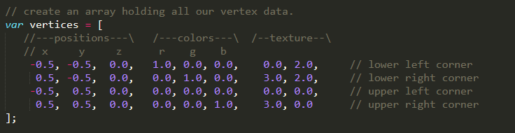
Adding a texture
Implementing the coordinates

Slide 86
Adding a texture
To-do list
Texture object
Loading image
Texture parameters
Texture in shader
Texture “vertices”
Texture attribute pointer

Slide 87
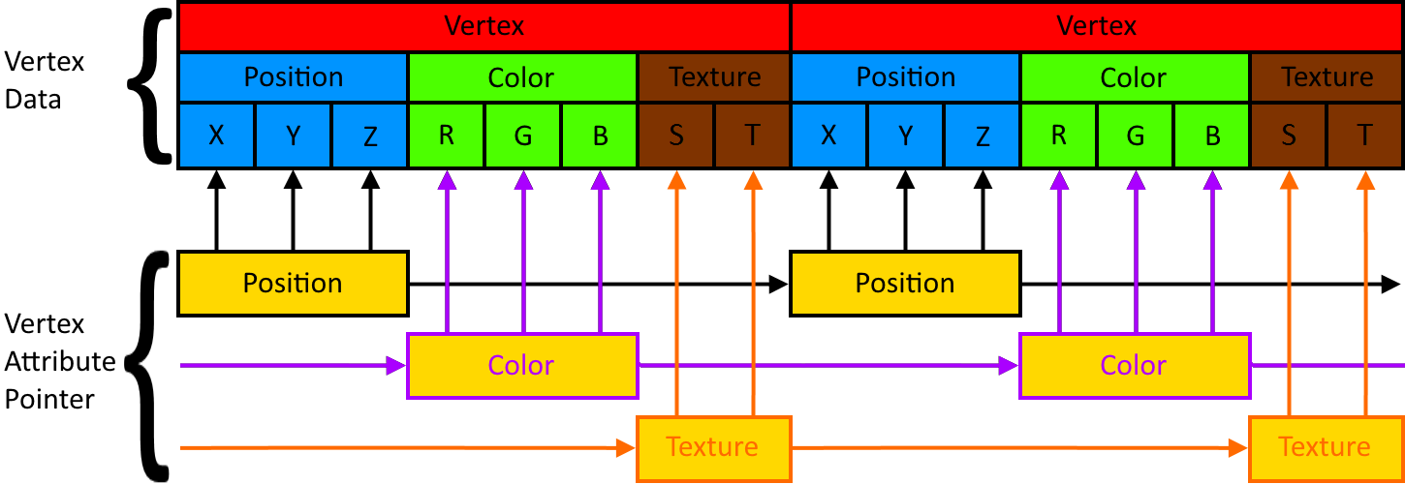
Adding a texture
The texture attribute pointer adds in just like the color attribute pointer.

Slide 88


Adding a texture
Add the texture vertex attribute pointer
Notes:
// 1st arg: pointer to the position where the vertex data can be inserted
// 2nd arg: number of components per vertex attribute
// 3rd arg: what type of data each vertex attribute will be
// 4th arg: normalization, this has no effect on floats, but will cast other types into their usual values
// 5th arg: specifies the offset in bytes between vertex attributes. In this case 8*4 because we have 8
// values per element (x,y,z,r,g,b,tx1,tx2) times 4 bytes (32 bit floats).
// 6th arg: offset, specifies at which position (in bytes) in the vertex array the first element starts.

Slide 89

Adding a texture
Enable the vertex attribute arrays

Slide 90
Adding a texture
To-do list
Texture object
Loading image
Texture parameters
Texture in shader
Texture “vertices”
Texture attribute pointer

Slide 91
Adding a texture
The final result:

Slide 92
Step 1: Adding a texture
Step 2: Math
Step 3: Applying math in WebGL
Disclaimer: I am not a mathematician
Notes:
2D/3D vectors
Matrices
Matrix · Vector

Slide 93



Math
What we discussed last time.
What you think you will learn.

Slide 94

Math
What you will actually learn.

Slide 95
Step 2: Math
2D/3D vectors
Matrices
Disclaimer: I am still not a mathematician
Notes:
Basic linear algebra for direct use in WebGL
2D/3D vectors
Matrices
Matrix · Vector

Slide 96
Math: 2D/3D vectors
To-do list
3D vector
Vector length
Unit vector
Dot product
Cross product

Slide 97
Math: 2D/3D vectors
Last time: addition and subtraction with 2D vectors.
2
5
3
1
v = v =
w = w =
Addition:
Subtraction:
v + w =
2 + 3
5 + 1
=
5
6
v - w =
2 - 3
5 - 1
=
-1
4
Notes:
This example shows why it is easier to write the numbers on top of each other. There are many other ways to manipulate vectors, like using a scalar to add/subtract etc, the dot product, the cross product, and many more. See http://higherorderfun.com/blog/2012/06/03/math-for-game-programmers-05-vector-cheat-sheet/ for more information

Slide 98
Math: 2D/3D vectors
Addition and subtraction with 3D vectors.
2
5
4
3
1
2
v = v =
w = w =
Addition:
Subtraction:
2 + 3
5 + 1
4 + 2
5
6
6
2 - 3
5 - 1
4 - 2
-1
4
2
v + w =
=
v - w =
=
Notes:
This example shows why it is easier to write the numbers on top of each other. There are many other ways to manipulate vectors, like using a scalar to add/subtract etc, the dot product, the cross product, and many more. See http://higherorderfun.com/blog/2012/06/03/math-for-game-programmers-05-vector-cheat-sheet/ for more information

Slide 99
Math: 2D/3D vectors
To-do list
3D vector
Vector length
Unit vector
Dot product
Cross product

Slide 100
Math: 2D/3D vectors
Length (or magnitude) of a vector:
indicates how far a vector travels
independent of direction
always positive
usually written as
|v|
Notes:
Length and magnitude are interchangeable terms when talking about vectors.
The length (or magnitude) of a vector is how far the vector travels independent of direction.
You can see length as “ignoring” the direction of the vector.
The length of a vector is denoted as a character between 2 (or 4) vertical lines: |v|
The length of a vector is always an absolute value, meaning it can not be negative. (joke)A little bit like an unsigned int
The length of a vector is calculated using this formula: |v| = √( (vx^2) + (vy^2) )

Slide 101
Math: 2D/3D vectors
The length (or magnitude) of a 2D vector:
|v| = √(vx) + (vy)
2
2
formula:
rearrangement of:
proof:
c = a + b
2
2
2
3
4
|v| = √(3) + (4) = 5
v = v =
2
2
Notes:
Length and magnitude are interchangeable terms when talking about vectors.

Slide 102
Math: 2D/3D vectors
The length (or magnitude) of a 3D vector:
|v| = √(vx) + (vy) + (vz)
2
2
2
formula:
rearrangement of:
proof:
d = a + b + c
2
2
2
2
3
4
5
v = v =
|v| = √(3) + (4) + (5) ≈ 7.07
2
2
2
Notes:
Length and magnitude are interchangeable terms when talking about vectors.

Slide 103
Math: 2D/3D vectors
To-do list
3D vector
Vector length
Unit vector
Dot product
Cross product

Slide 104
Math: 2D/3D vectors
The unit vector:
length of 1
useful in calculations
normalizing
usually written as
v
Notes:
Calculations that use Unit Vectors are often calculations that are only about direction (like facing a certain way). The actual size of the original vector does not matter in these cases.
A unit vector is the reverse of a vector length, as it only cares about direction, and not so much about how far in that direction.
A unit vector is a vector where the length of the vector equals 1.
A unit vector is denoted as a character with a roof over its head.
Unit vectors are really useful for calculations that use the length of a vector, as it will be 1.
A unit vector is calculated using this formula:
unit v = v / |v|
Calculating the unit vector is called normalizing a vector.

Slide 105
Math: 2D/3D vectors
Vector
The (2D) unit vector:
3
4
v = v / |v|
v = v =
formula:
proof:
3 / 5
4 / 5
0.6
0.8
v = =
Length
|v| = √(3) + (4) = 5
2
2
|v| = √(0.6) + (0.8) = √1 = 1
2
2
Notes:
Length and magnitude are interchangeable terms when talking about vectors.
|v| = √(sqrt(0.6) + sqrt(0.8)) = √(0.36 + 0.64) = √1 = 1

Slide 106
Math: 2D/3D vectors
Vector
The (3D) unit vector:
3
4
5
v = v / |v|
v = v =
formula:
proof:
3 / 7.07
4 / 7.07
5 / 7.07
0.424
0.566
0.707
v = ≈
Length
|v| = √(3) + (4) + (5)
≈ 7.07
2
2
2
2
2
|v| = √(0.424) + (0.566) + (0.707)
= √1 = 1
2
Notes:
Length and magnitude are interchangeable terms when talking about vectors.
|v|= √(sqrt(0.424) + sqrt(0.566) + sqrt(0.707)) = √(0.18 + 0.32 + 0.50) = √1 = 1

Slide 107
Math: 2D/3D vectors
To-do list
3D vector
Vector length
Unit vector
Dot product
Cross product

Slide 108
Math: 2D/3D vectors
The dot product:
“multiplying” vectors
results in a scalar
angle
usually written as
a · b
Notes:
The “dot product” may sometimes also be called the “scalar product" or “inner product”.
The dot product is very useful when determining vectors’ angle and direction.
When the vectors face the same direction, the outcome will be positive.
When the vectors are at a right angle (90 degrees), the outcome will be 0.
When the vectors are facing the opposite direction, the outcome will be negative.

Slide 109
Math: 2D/3D vectors
The dot product:
positive:
0:
negative
Notes:
The dot product is very useful when determining vectors’ angle and direction.
When the vectors face the same direction, the outcome will be positive.
When the vectors are at a right angle (90 degrees), the outcome will be 0.
When the vectors are facing the opposite direction, the outcome will be negative.

Slide 110
Math: 2D/3D vectors
The dot product:
Formula 1:
Formula 2:
a · b = |a|·|b|· cosθ
a · b = ax · bx + ay · by (+ az · bz )
Notes:
The dot product is very useful when determining vectors’ angle and direction.
When the vectors face the same direction, the outcome will be positive.
When the vectors are at a right angle (90 degrees), the outcome will be 0.
When the vectors are facing the opposite direction, the outcome will be negative.

Slide 111
Math: 2D/3D vectors
3
4
5
6
2
1
a = a =
b = b =
Vector
|a| = √(3) + (4) + (5) ≈ 7.07
2
2
2
Length
|b| = √(6) + (2) + (1) ≈ 6.4
2
2
2
3 / 7.07
4 / 7.07
5 / 7.07
0.424
0.566
0.707
a = a / |a| = ≈
Unit vector
6 / 6.4
2 / 6.4
1 / 6.4
0.938
0.313
0.156
b = b / |b| = ≈

Slide 112
Math: 2D/3D vectors
Let’s try to calculate the dot product.
a · b = ax · bx + ay · by + az · bz
Method 1
1.
a · b = 3 · 6 + 4 · 2 + 5 · 1
2.
a · b = 18 + 8 + 5
3.
a · b = 31
Notes:
To calculate the angle, just apply the formula with the unit vector and cos⁻¹ the result!

Slide 113
Math: 2D/3D vectors
Let’s try to calculate the dot product.
a · b = |a|·|b|· cosθ
Method 2
1.
31 = √50 · √41 · cosθ
2.
cosθ = 31 / (√50 · √41)
3.
cosθ ≈ 0.6847….
4.
θ = cos⁻¹ (0.6847….) = 46.79
5.
√50 · √41 · cos(46.79) = 31
Notes:
We know that the dot product of vector a and b is 31 from the previous example.
This method is hard because the angle (θ) has to be known as well.
cos⁻¹((a · b) / (|a|×|b|)) = θ

Slide 114
Math: 2D/3D vectors
To-do list
3D vector
Vector length
Unit vector
Dot product
Cross product

Slide 115
Math: 2D/3D vectors
The cross product:
“multiplying” vectors
results in a vector
right angle
usually written as
a x b
Notes:
The “cross product” may sometimes also be called the “outer product”.
It results in a vector that is at a right angle to both other vectors (90 degrees)

Slide 116
Math: 2D/3D vectors
The cross product:
Formula 1:
Formula 2:
ax
ay
az
bx
by
bz
ay · bz - az · by
az · bx - ax · bz
ax · by - ay · bx
cx
cy
cz
a × b =
×
=
=
a × b = |a|·|b|· sinθ · n
Notes:
We will only discuss the first formula
The “cross product” may sometimes also be called the “vector product” or “outer product”.
Theta = θ = plane angle
n = the unit vector perpendicular to the plane

Slide 117

Math: 2D/3D vectors
The cross product:
ax
ay
az
bx
by
bz
ay · bz - az · by
az · bx - ax · bz
ax · by - ay · bx
cx
cy
cz
a × b =
×
=
=
c
a × b = c
b
a
Notes:
Fun fact: Applying the dot product on any of the original vectors with the cross product results in 0 (because they are at a right angle)
Hand system (right hand):
a = index finger
b = middle finger
c = thumb
cos⁻¹((a · b) / (|a|×|b|)) = θ

Slide 118
Math: 2D/3D vectors
The cross product:
ax
ay
az
bx
by
bz
ay · bz - az · by
az · bx - ax · bz
ax · by - ay · bx
cx
cy
cz
a × b =
×
=
=
3
4
5
6
2
1
4 · 1 - 5 · 2
5 · 6 - 3 · 1
3 · 2 - 4 · 6
-6
27
-18
a × b =
×
=
=

Slide 119
Math: 2D/3D vectors
To-do list
3D vector
Vector length
Unit vector
Dot product
Cross product

Slide 120
Step 2: Math
2D/3D vectors
Matrices
Disclaimer: I am still not a mathematician
Notes:
Basic linear algebra for direct use in WebGL
2D/3D vectors
Matrices
Matrix · Vector

Slide 121



Math: Matrices
What you think you will learn
What your friends think you'll learn
What you will actually learn

Slide 122
Math: Matrices
To-do list
Matrix specifications
Matrix addition
Matrix multiplications
Identity matrix
Scale matrix
Translation matrix
Rotation matrix

Slide 123
Math: Matrices
A matrix:
is rectangular
n x n dimensions
represents a linear function
Notes:
A Matrix is a rectangular array with n x n dimensions.
A matrix can be filled with numbers, but also symbols or expressions.
The dimensions are the rows and columns.

Slide 124
Math: Matrices
A matrix:
usually written as
(3 x 3)
(2 x 2)
(3 x 2)
a1,1
a2,1
a3,1
a1,2
a2,2
a3,2
a1,3
a2,3
a3,3
a1,1
a2,1
a1,2
a2,2
a1,1
a2,1
a3,1
a1,2
a2,2
a3,2
Notes:
A Matrix is a rectangular array with n x n dimensions.
The dimensions are the rows and columns.
A matrix can be filled with numbers, but also symbols or expressions.

Slide 125
Math: Matrices
To-do list
Matrix specifications
Matrix addition
Matrix multiplications
Identity matrix
Scale matrix
Translation matrix
Rotation matrix

Slide 126
Math: Matrices
Matrix + Scalar
1
2
3
4
5
6
7
8
9
1 + 5
2 + 5
3 + 5
4 + 5
5 + 5
6 + 5
7 + 5
8 + 5
9 + 5
6
7
8
9
10
11
12
13
14
+ 5 =
=
Scalars will be applied to every element in the matrix.
Notes:
Subtraction / multiplication / division will also be applied to every member of the matrix, just like addition.

Slide 127
Math: Matrices
Matrix + Matrix
1
2
3
4
5
6
7
8
9
8
7
6
5
4
3
2
1
0
+
=
1 + 8
2 + 7
3 + 6
4 + 5
5 + 4
6 + 3
7 + 2
8 + 1
9 + 0
9
9
9
9
9
9
9
9
9
=
Notes:
Subtraction will be applied just like addition.

Slide 128
Math: Matrices
To-do list
Matrix specifications
Matrix addition
Matrix multiplications
Identity matrix
Scale matrix
Translation matrix
Rotation matrix

Slide 129
Math: Matrices
Matrix · Matrix
1
2
3
4
5
6
7
8
9
8
7
6
5
4
3
2
1
0
·
You can multiply a matrix as long as the amount of columns on the left equal the amount of rows on the right.
Notes:
Multiplying matrices is not commutative, meaning multiplying matrix A x matrix B does not equal matrix B x matrix A.

Slide 130
Math: Matrices
Matrix · Matrix
(1 · 8 + 4 · 7 + 7 · 6) (1 · 5 + 4 · 4 + 7 · 3) (1 · 2 + 4 · 1 + 7 · 0)
(2 · 8 + 5 · 7 + 8 · 6) (2 · 5 + 5 · 4 + 8 · 3) (2 · 2 + 5 · 1 + 8 · 0)
(3 · 8 + 6 · 7 + 9 · 6) (3 · 5 + 6 · 4 + 9 · 3) (3 · 2 + 6 · 1 + 9 · 0)
78
42
6
99
54
9
120
66
12

Slide 131
Math: Matrices
Matrix · Matrix
5 4 3
8
7
6
5
4
3
2
1
0
78
2 1 0
42
6
(1 · 0) +
(2 · 0) +
(3 · 0) +
8 7 6
(4 · 0) +
(5 · 0) +
(6 · 0) +
(7 · 0)
(8 · 0)
(9 · 0)
8 7 6
99
54
9
5 4 3
2 1 0
·
=
8 7 6
120
66
12
5 4 3
2 1 0
Notes:
Matrix multiplication can be difficult to get comfortable with without much practice.

Slide 132
Math: Matrices
Matrix · Matrix
Can you multiply these matrices?
1
2
3
4
5
6
7
8
9
8
7
6
5
4
3
·
Notes:
Multiplying matrices is only doable if the columns on the left side equal the rows on the right side.
Answer: Yes

Slide 133
Math: Matrices
Matrix · Matrix
Can you multiply these matrices?
1
2
3
4
5
6
8
7
6
5
4
3
·
Notes:
Multiplying matrices is only doable if the columns on the left side equal the rows on the right side.
Answer: No

Slide 134
Math: Matrices
Matrix · Vector
Can you multiply this matrix by this vector?
1
2
3
4
5
6
7
8
9
8
7
6
·
Notes:
Multiplying matrices is only doable if the columns on the left side equal the rows on the right side.
Answer: Yes

Slide 135
Math: Matrices
To-do list
Matrix specifications
Matrix addition
Matrix multiplications
Identity matrix
Scale matrix
Translation matrix
Rotation matrix

Slide 136
Math: Matrices
An identity matrix:
consists of 0’s
with diagonal 1’s
starting point
same result
Notes:
An identity matrix consists of only 0’s, with the diagonal 1’s as exception, ranging from the top left to the bottom right.
An identity matrix is often the starting point of linear functions.
Multiplying a matrix by the identity matrix results in the same matrix.

Slide 137
Math: Matrices
The identity matrix:
1
0
0
0
0
1
0
0
0
0
1
0
0
0
0
1
Notes:
The identity matrix is usually 4x4 because it is used in 3d space. The extra dimension allows for more space to use in special cases. We will encounter why this is useful in just a bit.

Slide 138
Math: Matrices
An identity matrix:
1
0
0
0
1
0
0
0
1
1
2
3
4
5
6
7
8
9
1
2
3
4
5
6
7
8
9
·
=
Notes:
The Identity matrix is usually the starting point for other transformation matrices.

Slide 139
Math: Matrices
To-do list
Matrix specifications
Matrix addition
Matrix multiplications
Identity matrix
Scale matrix
Translation matrix
Rotation matrix

Slide 140
Math: Matrices
A scale matrix:
diagonal scale factor
multiplies members of vector
modifies length
does not modify direction
Notes:
A scale matrix has the scale factors in a diagonal line, causing each member of a vector to be multiplied by the scale factor.
Scaling only modifies the length (magnitude) of a vector, leaving the direction intact.

Slide 141
Math: Matrices
A scale matrix:
S1
0
0
0
0
S2
0
0
0
0
S3
0
0
0
0
1
Notes:
The scale matrix scales each side by a certain amount, so we want each member of the vector to be multiplied by the scale factor.

Slide 142
Math: Matrices
A scale matrix:
S1
0
0
0
0
S2
0
0
0
0
S3
0
0
0
0
1
x
y
z
1
S1 · x
S2 · y
S3 · z
1
?
?
?
1
·
=
=
Notes:
Scaling a vector means modifying the magnitude of a vector, while keeping the direction the same.
The 4th dimension will be useless here. It will be useful during translation though.

Slide 143
Math: Matrices
A scale matrix:
Scaling each member by a factor 2.
2
0
0
0
0
2
0
0
0
0
2
0
0
0
0
1
3
4
5
1
2 · 3
2 · 4
2 · 5
1
6
8
10
1
·
=
=

Slide 144
Math: Matrices
To-do list
Matrix specifications
Matrix addition
Matrix multiplications
Identity matrix
Scale matrix
Translation matrix
Rotation matrix

Slide 145
Math: Matrices
A translation matrix:
column addition factor
adds to members of vector
modifies length
modifies direction
Notes:
A translation matrix has the addition factor in a column in the 4th dimension, causing each member to only be added to by the addition factor.

Slide 146
Math: Matrices
A translation matrix:
1
0
0
0
0
1
0
0
0
0
1
0
T1
T2
T3
1
Notes:
The translation matrix moves the vector in any direction, so we want each member of the vector to get a certain amount added

Slide 147
Math: Matrices
A translation matrix:
1
0
0
0
0
1
0
0
0
0
1
0
T1
T2
T3
1
x
y
z
1
x + T1
y + T2
z + T3
1
?
?
?
1
·
=
=
Notes:
Translating a vector means moving the vector in any direction.
The 4th dimension is very useful here, as it will allow us to just add something instead of multiplying it.

Slide 148
Math: Matrices
A translation matrix:
Translating with the vector [1, 2, 3].
1
0
0
0
0
1
0
0
0
0
1
0
1
2
3
1
3
4
5
1
3 + 1
4 + 2
5 + 3
1
4
6
8
1
·
=
=

Slide 149
Math: Matrices
To-do list
Matrix specifications
Matrix addition
Matrix multiplications
Identity matrix
Scale matrix
Translation matrix
Rotation matrix

Slide 150
Math: Matrices
A rotation matrix:
rotates around an axis
modifies other 2 axis
does not modify length
modifies direction
Notes:
A rotation matrix rotates around an axis, meaning only that specific axis will stay unmodified while turning around the other 2 axis.
This means the length of the vectors are not modified, but positions will be modified in a sine-wave-like movement.

Slide 151
Math: Matrices
Rotation matrices:
x-axis
y-axis
z-axis
1
0
0
0
0
cos(θ)
-sin(θ)
0
0
sin(θ)
cos(θ)
0
0
0
0
1
cos(θ)
0
sin(θ)
0
0
1
0
0
-sin(θ)
0
cos(θ)
0
0
0
0
1
cos(θ)
-sin(θ)
0
0
sin(θ)
cos(θ)
0
0
0
0
1
0
0
0
0
1
Notes:
Each axis has its own rotation matrix. Surprise!
Notice how each matrix only has values in the other 2 axis.
The base for each matrix is of course the identity matrix.

Slide 152
Math part 4: Matrix · Vector
x-axis rotation matrix:
1
0
0
0
0
cos(θ)
-sin(θ)
0
0
sin(θ)
cos(θ)
0
0
0
0
1
x
y
z
1
x
y · cos(θ) + z · sin(θ)
y · -sin(θ) + z · cos(θ)
1
?
?
?
1
·
=
=
(θ is the rotation)
Notes:
The slides show clockwise rotation. Rotating counter-clockwise is easily done by only moving the ‘-’ before the -sin to the sin without ‘-’.

Slide 153
Math part 4: Matrix · Vector
x-axis rotation matrix:
Rotating by 1 radian. (almost 57.3 degrees)
1
0
0
0
0
cos(1)
-sin(1)
0
0
sin(1)
cos(1)
0
0
0
0
1
3
4
5
1
3
4 · 0.54 + 5 · 0.84
4 · -0.84 + 5 · 0.54
1
3
6.37
-0.66
1
·
=
=
(Rotation in radians)
Notes:
We use radians here because JavaScript’s Math.cos() and Math.sin() functions use radian as input.
3 * cos(1) = 1,6209069176044191522028098223289
4 * cos(1) = 2,1612092234725588696037464297719
5 * cos(1) = 2,7015115293406985870046830372149
3 * sin(1) = 2,5244129544236895199575069648909
4 * sin(1) = 3,3658839392315860266100092865212
5 * sin(1) = 4,2073549240394825332625116081515
3 * -sin(1) = -2,5244129544236895199575069648909
4 * -sin(1) = -3,3658839392315860266100092865212
5 * -sin(1) = -4,2073549240394825332625116081515

Slide 154
Math part 4: Matrix · Vector
y-axis rotation matrix:
cos(θ)
0
sin(θ)
0
0
1
0
0
-sin(θ)
0
cos(θ)
0
0
0
0
1
x
y
z
1
x · cos(θ) + z · -sin(θ)
y
x · sin(θ) + z · cos(θ)
1
?
?
?
1
·
=
=
(θ is the rotation)
Notes:
The slides show clockwise rotation. Rotating counter-clockwise is easily done by only moving the ‘-’ before the -sin to the sin without ‘-’.

Slide 155
Math part 4: Matrix · Vector
y-axis rotation matrix:
Rotating by 1 radian. (almost 57.3 degrees)
cos(1)
0
sin(1)
0
0
1
0
0
-sin(1)
0
cos(1)
0
0
0
0
1
3
4
5
1
3 · 0.54 + 5 · -0.84
4
3 · 0.84 + 5 · 0.54
1
-2.59
4
5.23
1
·
=
=
(Rotation in radians)
Notes:
We use radians here because JavaScript’s Math.cos() and Math.sin() functions use radian as input.
3 * cos(1) = 1,6209069176044191522028098223289
4 * cos(1) = 2,1612092234725588696037464297719
5 * cos(1) = 2,7015115293406985870046830372149
3 * sin(1) = 2,5244129544236895199575069648909
4 * sin(1) = 3,3658839392315860266100092865212
5 * sin(1) = 4,2073549240394825332625116081515
3 * -sin(1) = -2,5244129544236895199575069648909
4 * -sin(1) = -3,3658839392315860266100092865212
5 * -sin(1) = -4,2073549240394825332625116081515

Slide 156
Math part 4: Matrix · Vector
z-axis rotation matrix:
cos(θ)
-sin(θ)
0
0
sin(θ)
cos(θ)
0
0
0
0
1
0
0
0
0
1
x
y
z
1
x · cos(θ) + y · sin(θ)
x · -sin(θ) + y · cos(θ)
z
1
?
?
?
1
·
=
=
(θ is the rotation)
Notes:
The slides show clockwise rotation. Rotating counter-clockwise is easily done by only moving the ‘-’ before the -sin to the sin without ‘-’.

Slide 157
Math part 4: Matrix · Vector
z-axis rotation matrix:
Rotating by 1 radian. (almost 57.3 degrees)
cos(1)
-sin(1)
0
0
sin(1)
cos(1)
0
0
0
0
1
0
0
0
0
1
3
4
5
1
3 · 0.54 + 4 · 0.84
3 · -0.84 + 4 · 0.54
5
1
4.99
-0.36
5
1
·
=
=
(Rotation in radians)
Notes:
We use radians here because JavaScript’s Math.cos() and Math.sin() functions use radian as input.
3 * cos(1) = 1,6209069176044191522028098223289
4 * cos(1) = 2,1612092234725588696037464297719
5 * cos(1) = 2,7015115293406985870046830372149
3 * sin(1) = 2,5244129544236895199575069648909
4 * sin(1) = 3,3658839392315860266100092865212
5 * sin(1) = 4,2073549240394825332625116081515
3 * -sin(1) = -2,5244129544236895199575069648909
4 * -sin(1) = -3,3658839392315860266100092865212
5 * -sin(1) = -4,2073549240394825332625116081515

Slide 158
Math: Matrices
To-do list
Matrix specifications
Matrix addition
Matrix multiplications
Identity matrix
Scale matrix
Translation matrix
Rotation matrix

Slide 159
Step 1: Adding a texture
Step 2: Math
Step 3: Applying math in WebGL
Disclaimer: I am not a mathematician

Slide 160



Applying the math
How much we’ve learned so far.
How much we still have to learn.
What’s left for us to do in this session.

Slide 161
Applying the math
To-do list
Create math library
Edit Vertex Shader
Identity matrix code
Matrix multiplications code
Scale matrix in code
Translation matrix in code
Rotation matrices in code
Notes:
These subjects will be short (I promise)

Slide 162

Applying the math
We’ll build our own small math library.
Notes:
We will build our own small math library to help us with matrix math. This means we only have to do it right once, and we’re set for life (sort of).
First create a variable holding all the math functions. We will use this variable like we would use a static class.

Slide 163

Applying the math
Converter for radians/degrees.
Notes:
Just because I like working with degrees, here’s a small converter.

Slide 164
Applying the math
To-do list
Create math library
Edit Vertex Shader
Identity matrix code
Matrix multiplications code
Scale matrix in code
Translation matrix in code
Rotation matrices in code
Notes:
These subjects will be short (I promise)

Slide 165

Applying the math
Change the Vertex Shader.
We only supply the transformation
Notes:
We only supply the transformation. GLSL can do matrix * vector calculations by itself just fine.
uniform mat4 transform is a matrix of 4*4 dimensions.
The order of vector / matrix is very important!!
Right now the matrix is row-major, but flipping them will cause it to be column-major.
Example for translation matrix:
Column major in memory:
1, 0 ,0 ,0,
0, 1 ,0 ,0,
0, 0 ,1 ,0,
t1,t2,t3,1
our layout in memory:
1, 0, 0, t1,
0, 1, 0, t2,
0, 0, 1, t3,
0, 0, 0, 1

Slide 166
Applying the math
Get the transform uniform location in the vertex shader.
Supply our transform matrix.
Notes:
The matrix variable is the transformation we want to apply to all the vertices using our shader program.
uniformMatrix4fv: Put a matrix of 4-component vectors (v) with floating point values (f) into the uniform location.

Slide 167
Applying the math
To-do list
Create math library
Edit Vertex Shader
Identity matrix code
Matrix multiplications code
Scale matrix in code
Translation matrix in code
Rotation matrices in code
Notes:
These subjects will be short (I promise)

Slide 168
Applying the math
The identity matrix:
1
0
0
0
0
1
0
0
0
0
1
0
0
0
0
1
Notes:
The identity matrix is usually 4x4 because it is used in 3d space. The extra dimension allows for more space to use in special cases. We will encounter why this is useful in just a bit.

Slide 169

Applying the math
Identity matrix function:
This calls returns an identity matrix:
Notes:
The Identity matrix is usually the starting point for other transformation matrices.

Slide 170
Applying the math
To-do list
Create math library
Edit Vertex Shader
Identity matrix code
Matrix multiplications code
Scale matrix in code
Translation matrix in code
Rotation matrices in code
Notes:
These subjects will be short (I promise)

Slide 171
Applying the math
Matrix · Matrix
(1 · 8 + 4 · 7 + 7 · 6) (1 · 5 + 4 · 4 + 7 · 3) (1 · 2 + 4 · 1 + 7 · 0)
(2 · 8 + 5 · 7 + 8 · 6) (2 · 5 + 5 · 4 + 8 · 3) (2 · 2 + 5 · 1 + 8 · 0)
(3 · 8 + 6 · 7 + 9 · 6) (3 · 5 + 6 · 4 + 9 · 3) (3 · 2 + 6 · 1 + 9 · 0)
78
42
6
99
54
9
120
66
12

Slide 172

Applying the math
The matrix multiplication function:
(Calculates 1 array item per line, 16 in total)
Notes:
Notice that we have a 4d matrix instead of the 3d matrix in the previous slide

Slide 173
Applying the math
To-do list
Create math library
Edit Vertex Shader
Identity matrix code
Matrix multiplications code
Scale matrix in code
Translation matrix in code
Rotation matrices in code
Notes:
These subjects will be short (I promise)

Slide 174
Applying the math
A scale matrix:
S1
0
0
0
0
S2
0
0
0
0
S3
0
0
0
0
1
x
y
z
1
S1 · x
S2 · y
S3 · z
1
?
?
?
1
·
=
=
Notes:
Scaling a vector means modifying the magnitude of a vector, while keeping the direction the same.
The 4th dimension will be useless here. It will be useful during translation though.

Slide 175


Applying the math
The code for the scale function.
Usage

Slide 176


Applying the math
Scaling by 1.5:

Slide 177
Applying the math
To-do list
Create math library
Edit Vertex Shader
Identity matrix code
Matrix multiplications code
Scale matrix in code
Translation matrix in code
Rotation matrices in code
Notes:
These subjects will be short (I promise)

Slide 178
Applying the math
A translation matrix:
1
0
0
0
0
1
0
0
0
0
1
0
T1
T2
T3
1
x
y
z
1
x + T1
y + T2
z + T3
1
?
?
?
1
·
=
=
Notes:
Translating a vector means moving the vector in any direction.
The 4th dimension is very useful here, as it will allow us to just add something instead of multiplying it.

Slide 179


Applying the math
The code for the translate function.
Usage

Slide 180

Applying the math
Translating by [0.2, 0.2, 0.2]:
Notes:
What goes wrong here?
Aside from the orthographic projection (mimics sense of depth) we are still missing fundamental parts of our space.
We currently only have a screen space.
What we need:
Local space (or Object space)
World space
View space (or Eye space)
Clip space
Screen space

Slide 181
Applying the math
To-do list
Create math library
Edit Vertex Shader
Identity matrix code
Matrix multiplications code
Scale matrix in code
Translation matrix in code
Rotation matrices in code
Notes:
These subjects will be short (I promise)

Slide 182
Applying the math
An x-axis rotation matrix:
1
0
0
0
0
cos(θ)
-sin(θ)
0
0
sin(θ)
cos(θ)
0
0
0
0
1
x
y
z
1
x
y · cos(θ) + z · sin(θ)
y · -sin(θ) + z · cos(θ)
1
?
?
?
1
·
=
=
Notes:
The slides show clockwise rotation. Rotating counter-clockwise is easily done by only moving the ‘-’ before the -sin to the sin without ‘-’.

Slide 183


Applying the math
The code for the x rotation function.
Usage

Slide 184

Applying the math
Rotating around the x axis by 75 degrees.
Notes:
What goes wrong here?
Aside from the orthographic projection (mimics sense of depth) we are still missing fundamental parts of our space.
We currently only have a screen space.
What we need:
Local space (or Object space)
World space
View space (or Eye space)
Clip space
Screen space

Slide 185
Applying the math
A y-axis rotation matrix:
cos(θ)
0
sin(θ)
0
0
1
0
0
-sin(θ)
0
cos(θ)
0
0
0
0
1
x
y
z
1
x · cos(θ) + z · -sin(θ)
y
x · sin(θ) + z · cos(θ)
1
?
?
?
1
·
=
=

Slide 186


Applying the math
The code for the y rotation function.
Usage

Slide 187

Math part 4: Matrix · Vector
Rotating around the y axis by 75 degrees.
Notes:
What goes wrong here?
Aside from the orthographic projection (mimics sense of depth) we are still missing fundamental parts of our space.
We currently only have a screen space.
What we need:
Local space (or Object space)
World space
View space (or Eye space)
Clip space
Screen space

Slide 188
Applying the math
A z-axis rotation matrix:
cos(θ)
-sin(θ)
0
0
sin(θ)
cos(θ)
0
0
0
0
1
0
0
0
0
1
x
y
z
1
x · cos(θ) + y · sin(θ)
x · -sin(θ) + y · cos(θ)
z
1
?
?
?
1
·
=
=

Slide 189


Applying the math
The code for the z rotation function.
Usage

Slide 190

Applying the math
Rotating around the z axis by 75 degrees.
Notes:
What goes wrong here?
Aside from the orthographic projection (mimics sense of depth) we are still missing fundamental parts of our space.
We currently only have a screen space.
What we need:
Local space (or Object space)
World space
View space (or Eye space)
Clip space
Screen space

Slide 191
Applying the math
To-do list
Create math library
Edit Vertex Shader
Identity matrix code
Matrix multiplications code
Scale matrix in code
Translation matrix in code
Rotation matrices in code
Notes:
These subjects will be short (I promise)

Slide 192
To be continued next time…

Slide 193
Thanks for listening.

Slide 195
Part IV
Presentation by: Quincy Jacobs
Notes:
Part IV will ...
https://github.com/QuincyJacobs/WebGLTutorial

